Slide 1

COMPUTER SYSTEMS ARCHITECTURE (2)
Maurizio Fiusco

Slide 2
Hamming Code
Calculate the error correction bits to add to the binary word 1B₁₆
1 |  |  |  | B
₁₆
₂

Slide 3
Hamming Code
Calculate the error correction bits to add to the binary word 1B₁₆
1 |  |  |  | B
₁₆
₂

Slide 4
Hamming Code
Calculate the error correction bits to add to the binary word 1B₁₆
1 |  |  |  | B
 |  |  |  | 1 | 0 | 1 | 1
₁₆
₂

Slide 5
Hamming Code
Calculate the error correction bits to add to the binary word 1B₁₆
1 |  |  |  | B
 |  |  |  | 1 | 0 | 1 | 1
₁₆
₂

Slide 6
Hamming Code
Calculate the error correction bits to add to the binary word 1B₁₆
1 |  |  |  | B
0 | 0 | 0 | 1 | 1 | 0 | 1 | 1
₁₆
₂

Slide 7
Hamming Code
Calculate the error correction bits to add to the binary word 1B₁₆
1 |  |  |  | B
0 | 0 | 0 | 1 | 1 | 0 | 1 | 1
₁₆
₂
m = 8

Slide 8
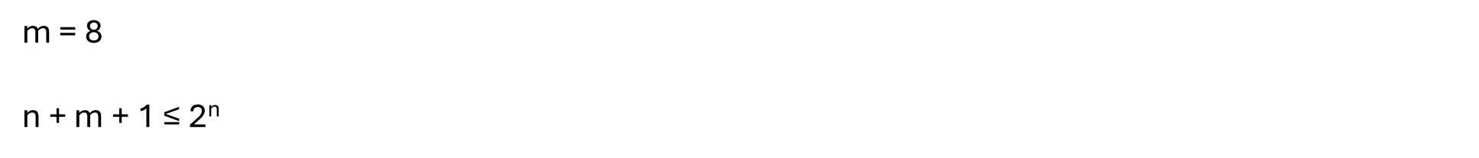
Hamming Code
Calculate the error correction bits to add to the binary word 1B₁₆
1 |  |  |  | B
0 | 0 | 0 | 1 | 1 | 0 | 1 | 1
₁₆
₂
m = 8
n + m + 1 $\text{≤}$ 2^{n}

Slide 9
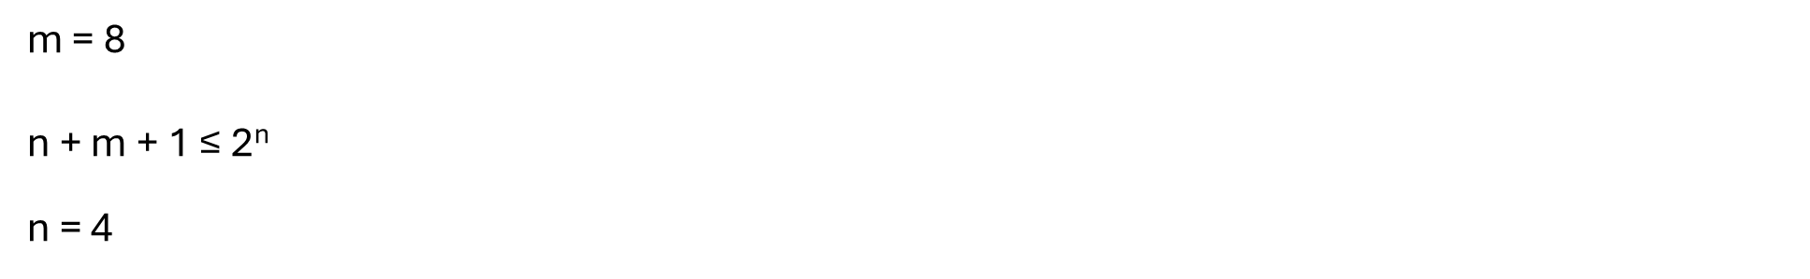
Hamming Code
Calculate the error correction bits to add to the binary word 1B₁₆
1 |  |  |  | B
0 | 0 | 0 | 1 | 1 | 0 | 1 | 1
₁₆
₂
m = 8
n + m + 1 $\text{≤}$ 2^{n}
n = 4

Slide 10
Hamming Code
Calculate the error correction bits to add to the binary word 1B₁₆

Slide 11
Hamming Code
Calculate the error correction bits to add to the binary word 1B₁₆

Slide 12
Hamming Code
Calculate the error correction bits to add to the binary word 1B₁₆
 |  |  |  |  |  |  | b₃ |  |  |  | b₂ |  | b₁ | b₀

Slide 13
Hamming Code
Calculate the error correction bits to add to the binary word 1B₁₆
 |  |  | 0 | 0 | 0 | 1 | b₃ | 1 | 0 | 1 | b₂ | 1 | b₁ | b₀

Slide 14
Hamming Code
Calculate the error correction bits to add to the binary word 1B₁₆
12 | 11 | 10 | 9 | 8 | 7 | 6 | 5 | 4 | 3 | 2 | 1
0 | 0 | 0 | 1 | b₃ | 1 | 0 | 1 | b₂ | 1 | b₁ | b₀

Slide 15
Hamming Code
Calculate the error correction bits to add to the binary word 1B₁₆
12 | 11 | 10 | 9 | 8 | 7 | 6 | 5 | 4 | 3 | 2 | 1
0 | 0 | 0 | 1 | b₃ | 1 | 0 | 1 | b₂ | 1 | b₁ | b₀
 |  |  |  |  |  |  |  |  |  |  | 👮‍♀️

Slide 16
Hamming Code
Calculate the error correction bits to add to the binary word 1B₁₆
12 | 11 | 10 | 9 | 8 | 7 | 6 | 5 | 4 | 3 | 2 | 1
0 | 0 | 0 | 1 | b₃ | 1 | 0 | 1 | b₂ | 1 | b₁ | b₀
 | 📌 |  | 📌 |  | 📌 |  | 📌 |  | 📌 |  | 👮‍♀️

Slide 17
Hamming Code
Calculate the error correction bits to add to the binary word 1B₁₆
12 | 11 | 10 | 9 | 8 | 7 | 6 | 5 | 4 | 3 | 2 | 1
0 | 0 | 0 | 1 | b₃ | 1 | 0 | 1 | b₂ | 1 | b₁ | b₀
 | 📌 |  | 📌 |  | 📌 |  | 📌 |  | 📌 |  | 👮‍♀️
 |  |  |  |  |  |  |  |  |  | 👮‍♀️

Slide 18
Hamming Code
Calculate the error correction bits to add to the binary word 1B₁₆
12 | 11 | 10 | 9 | 8 | 7 | 6 | 5 | 4 | 3 | 2 | 1
0 | 0 | 0 | 1 | b₃ | 1 | 0 | 1 | b₂ | 1 | b₁ | b₀
 | 📌 |  | 📌 |  | 📌 |  | 📌 |  | 📌 |  | 👮‍♀️
 | 📌 | 📌 |  |  | 📌 | 📌 |  |  | 📌 | 👮‍♀️

Slide 19
Hamming Code
Calculate the error correction bits to add to the binary word 1B₁₆
12 | 11 | 10 | 9 | 8 | 7 | 6 | 5 | 4 | 3 | 2 | 1
0 | 0 | 0 | 1 | b₃ | 1 | 0 | 1 | b₂ | 1 | b₁ | b₀
 | 📌 |  | 📌 |  | 📌 |  | 📌 |  | 📌 |  | 👮‍♀️
 | 📌 | 📌 |  |  | 📌 | 📌 |  |  | 📌 | 👮‍♀️
 |  |  |  |  |  |  |  | 👮‍♀️

Slide 20
Hamming Code
Calculate the error correction bits to add to the binary word 1B₁₆
12 | 11 | 10 | 9 | 8 | 7 | 6 | 5 | 4 | 3 | 2 | 1
0 | 0 | 0 | 1 | b₃ | 1 | 0 | 1 | b₂ | 1 | b₁ | b₀
 | 📌 |  | 📌 |  | 📌 |  | 📌 |  | 📌 |  | 👮‍♀️
 | 📌 | 📌 |  |  | 📌 | 📌 |  |  | 📌 | 👮‍♀️
📌 |  |  |  |  | 📌 | 📌 | 📌 | 👮‍♀️

Slide 21
Hamming Code
Calculate the error correction bits to add to the binary word 1B₁₆
12 | 11 | 10 | 9 | 8 | 7 | 6 | 5 | 4 | 3 | 2 | 1
0 | 0 | 0 | 1 | b₃ | 1 | 0 | 1 | b₂ | 1 | b₁ | b₀
 | 📌 |  | 📌 |  | 📌 |  | 📌 |  | 📌 |  | 👮‍♀️
 | 📌 | 📌 |  |  | 📌 | 📌 |  |  | 📌 | 👮‍♀️
📌 |  |  |  |  | 📌 | 📌 | 📌 | 👮‍♀️
 |  |  |  | 👮‍♀️

Slide 22
Hamming Code
Calculate the error correction bits to add to the binary word 1B₁₆
12 | 11 | 10 | 9 | 8 | 7 | 6 | 5 | 4 | 3 | 2 | 1
0 | 0 | 0 | 1 | b₃ | 1 | 0 | 1 | b₂ | 1 | b₁ | b₀
 | 📌 |  | 📌 |  | 📌 |  | 📌 |  | 📌 |  | 👮‍♀️
 | 📌 | 📌 |  |  | 📌 | 📌 |  |  | 📌 | 👮‍♀️
📌 |  |  |  |  | 📌 | 📌 | 📌 | 👮‍♀️
📌 | 📌 | 📌 | 📌 | 👮‍♀️

Slide 23
Hamming Code
Calculate the error correction bits to add to the binary word 1B₁₆
12 | 11 | 10 | 9 | 8 | 7 | 6 | 5 | 4 | 3 | 2 | 1
0 | 0 | 0 | 1 | b₃ | 1 | 0 | 1 | b₂ | 1 | b₁ | b₀
 | 📌 |  | 📌 |  | 📌 |  | 📌 |  | 📌 |  | 👮‍♀️
 | 📌 | 📌 |  |  | 📌 | 📌 |  |  | 📌 | 👮‍♀️
📌 |  |  |  |  | 📌 | 📌 | 📌 | 👮‍♀️
📌 | 📌 | 📌 | 📌 | 👮‍♀️

Slide 24
Hamming Code
Calculate the error correction bits to add to the binary word 1B₁₆
12 | 11 | 10 | 9 | 8 | 7 | 6 | 5 | 4 | 3 | 2 | 1
0 | 0 | 0 | 1 | b₃ | 1 | 0 | 1 | b₂ | 1 | b₁ | 0
 | 📌 |  | 📌 |  | 📌 |  | 📌 |  | 📌 |  | 👮‍♀️
 | 📌 | 📌 |  |  | 📌 | 📌 |  |  | 📌 | 👮‍♀️
📌 |  |  |  |  | 📌 | 📌 | 📌 | 👮‍♀️
📌 | 📌 | 📌 | 📌 | 👮‍♀️

Slide 25
Hamming Code
Calculate the error correction bits to add to the binary word 1B₁₆
12 | 11 | 10 | 9 | 8 | 7 | 6 | 5 | 4 | 3 | 2 | 1
0 | 0 | 0 | 1 | b₃ | 1 | 0 | 1 | b₂ | 1 | b₁ | 0
 | 📌 |  | 📌 |  | 📌 |  | 📌 |  | 📌 |  | 👮‍♀️
 | 📌 | 📌 |  |  | 📌 | 📌 |  |  | 📌 | 👮‍♀️
📌 |  |  |  |  | 📌 | 📌 | 📌 | 👮‍♀️
📌 | 📌 | 📌 | 📌 | 👮‍♀️

Slide 26
Hamming Code
Calculate the error correction bits to add to the binary word 1B₁₆
12 | 11 | 10 | 9 | 8 | 7 | 6 | 5 | 4 | 3 | 2 | 1
0 | 0 | 0 | 1 | b₃ | 1 | 0 | 1 | b₂ | 1 | 0 | 0
 | 📌 |  | 📌 |  | 📌 |  | 📌 |  | 📌 |  | 👮‍♀️
 | 📌 | 📌 |  |  | 📌 | 📌 |  |  | 📌 | 👮‍♀️
📌 |  |  |  |  | 📌 | 📌 | 📌 | 👮‍♀️
📌 | 📌 | 📌 | 📌 | 👮‍♀️

Slide 27
Hamming Code
Calculate the error correction bits to add to the binary word 1B₁₆
12 | 11 | 10 | 9 | 8 | 7 | 6 | 5 | 4 | 3 | 2 | 1
0 | 0 | 0 | 1 | b₃ | 1 | 0 | 1 | b₂ | 1 | 0 | 0
 | 📌 |  | 📌 |  | 📌 |  | 📌 |  | 📌 |  | 👮‍♀️
 | 📌 | 📌 |  |  | 📌 | 📌 |  |  | 📌 | 👮‍♀️
📌 |  |  |  |  | 📌 | 📌 | 📌 | 👮‍♀️
📌 | 📌 | 📌 | 📌 | 👮‍♀️

Slide 28
Hamming Code
Calculate the error correction bits to add to the binary word 1B₁₆
12 | 11 | 10 | 9 | 8 | 7 | 6 | 5 | 4 | 3 | 2 | 1
0 | 0 | 0 | 1 | b₃ | 1 | 0 | 1 | 0 | 1 | 0 | 0
 | 📌 |  | 📌 |  | 📌 |  | 📌 |  | 📌 |  | 👮‍♀️
 | 📌 | 📌 |  |  | 📌 | 📌 |  |  | 📌 | 👮‍♀️
📌 |  |  |  |  | 📌 | 📌 | 📌 | 👮‍♀️
📌 | 📌 | 📌 | 📌 | 👮‍♀️

Slide 29
Hamming Code
Calculate the error correction bits to add to the binary word 1B₁₆
12 | 11 | 10 | 9 | 8 | 7 | 6 | 5 | 4 | 3 | 2 | 1
0 | 0 | 0 | 1 | b₃ | 1 | 0 | 1 | 0 | 1 | 0 | 0
 | 📌 |  | 📌 |  | 📌 |  | 📌 |  | 📌 |  | 👮‍♀️
 | 📌 | 📌 |  |  | 📌 | 📌 |  |  | 📌 | 👮‍♀️
📌 |  |  |  |  | 📌 | 📌 | 📌 | 👮‍♀️
📌 | 📌 | 📌 | 📌 | 👮‍♀️

Slide 30
Hamming Code
Calculate the error correction bits to add to the binary word 1B₁₆
12 | 11 | 10 | 9 | 8 | 7 | 6 | 5 | 4 | 3 | 2 | 1
0 | 0 | 0 | 1 | 1 | 1 | 0 | 1 | 0 | 1 | 0 | 0
 | 📌 |  | 📌 |  | 📌 |  | 📌 |  | 📌 |  | 👮‍♀️
 | 📌 | 📌 |  |  | 📌 | 📌 |  |  | 📌 | 👮‍♀️
📌 |  |  |  |  | 📌 | 📌 | 📌 | 👮‍♀️
📌 | 📌 | 📌 | 📌 | 👮‍♀️

Slide 31
Hamming Code
Assuming the sequence 2B1₁₆ is received, calculate the control bits

Slide 32
Hamming Code
Assuming the sequence 2B1₁₆ is received, calculate the control bits
12 | 11 | 10 | 9 | 8 | 7 | 6 | 5 | 4 | 3 | 2 | 1

Slide 33
Hamming Code
Assuming the sequence 2B1₁₆ is received, calculate the control bits
12 | 11 | 10 | 9 | 8 | 7 | 6 | 5 | 4 | 3 | 2 | 1
0 | 0 | 1 | 0 | 1 | 0 | 1 | 1 | 0 | 0 | 0 | 1

Slide 34
Hamming Code
Assuming the sequence 2B1₁₆ is received, calculate the control bits
12 | 11 | 10 | 9 | 8 | 7 | 6 | 5 | 4 | 3 | 2 | 1
0 | 0 | 1 | 0 | 1 | 0 | 1 | 1 | 0 | 0 | 0 | 1

Slide 35
Hamming Code
Assuming the sequence 2B1₁₆ is received, calculate the control bits
12 | 11 | 10 | 9 | 8 | 7 | 6 | 5 | 4 | 3 | 2 | 1
0 | 0 | 1 | 0 | 1 | 0 | 1 | 1 | 0 | 0 | 0 | 1
 | 📌 |  | 📌 |  | 📌 |  | 📌 |  | 📌 |  | 👮‍♀️
 | 📌 | 📌 |  |  | 📌 | 📌 |  |  | 📌 | 👮‍♀️
📌 |  |  |  |  | 📌 | 📌 | 📌 | 👮‍♀️
📌 | 📌 | 📌 | 📌 | 👮‍♀️

Slide 36
Hamming Code
Assuming the sequence 2B1₁₆ is received, calculate the control bits
12 | 11 | 10 | 9 | 8 | 7 | 6 | 5 | 4 | 3 | 2 | 1
0 | 0 | 1 | 0 | 1 | 0 | 1 | 1 | 0 | 0 | 0 | 1
 | 📌 |  | 📌 |  | 📌 |  | 📌 |  | 📌 |  | 👮‍♀️
 | 📌 | 📌 |  |  | 📌 | 📌 |  |  | 📌 | 👮‍♀️
📌 |  |  |  |  | 📌 | 📌 | 📌 | 👮‍♀️
📌 | 📌 | 📌 | 📌 | 👮‍♀️
⚠️

Slide 37
Hamming Code
Assuming the sequence 2B1₁₆ is received, calculate the control bits
12 | 11 | 10 | 9 | 8 | 7 | 6 | 5 | 4 | 3 | 2 | 1
0 | 0 | 1 | 0 | 1 | 0 | 1 | 1 | 0 | 0 | 0 | 1
 | 📌 |  | 📌 |  | 📌 |  | 📌 |  | 📌 |  | 📌
 | 📌 | 📌 |  |  | 📌 | 📌 |  |  | 📌 | 📌
📌 |  |  |  |  | 📌 | 📌 | 📌 | 📌
📌 | 📌 | 📌 | 📌 | 📌
⚠️

Slide 38
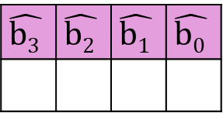
Hamming Code
Assuming the sequence 2B1₁₆ is received, calculate the control bits
12 | 11 | 10 | 9 | 8 | 7 | 6 | 5 | 4 | 3 | 2 | 1
0 | 0 | 1 | 0 | 1 | 0 | 1 | 1 | 0 | 0 | 0 | 1
 | 📌 |  | 📌 |  | 📌 |  | 📌 |  | 📌 |  | 📌
 | 📌 | 📌 |  |  | 📌 | 📌 |  |  | 📌 | 📌
📌 |  |  |  |  | 📌 | 📌 | 📌 | 📌
📌 | 📌 | 📌 | 📌 | 📌
$$\hat{{\text{b}}_{\text{3}}}$$ | $$\hat{{\text{b}}_{\text{2}}}$$ | $$\hat{{\text{b}}_{\text{1}}}$$ | $$\hat{{\text{b}}_{\text{0}}}$$
⚠️

Slide 39
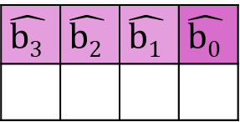
Hamming Code
Assuming the sequence 2B1₁₆ is received, calculate the control bits
12 | 11 | 10 | 9 | 8 | 7 | 6 | 5 | 4 | 3 | 2 | 1
0 | 0 | 1 | 0 | 1 | 0 | 1 | 1 | 0 | 0 | 0 | 1
 | 📌 |  | 📌 |  | 📌 |  | 📌 |  | 📌 |  | 📌
 | 📌 | 📌 |  |  | 📌 | 📌 |  |  | 📌 | 📌
📌 |  |  |  |  | 📌 | 📌 | 📌 | 📌
📌 | 📌 | 📌 | 📌 | 📌
$$\hat{{\text{b}}_{\text{3}}}$$ | $$\hat{{\text{b}}_{\text{2}}}$$ | $$\hat{{\text{b}}_{\text{1}}}$$ | $$\hat{{\text{b}}_{\text{0}}}$$
⚠️

Slide 40
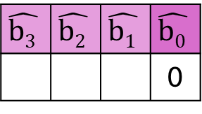
Hamming Code
Assuming the sequence 2B1₁₆ is received, calculate the control bits
12 | 11 | 10 | 9 | 8 | 7 | 6 | 5 | 4 | 3 | 2 | 1
0 | 0 | 1 | 0 | 1 | 0 | 1 | 1 | 0 | 0 | 0 | 1
 | 📌 |  | 📌 |  | 📌 |  | 📌 |  | 📌 |  | 📌
 | 📌 | 📌 |  |  | 📌 | 📌 |  |  | 📌 | 📌
📌 |  |  |  |  | 📌 | 📌 | 📌 | 📌
📌 | 📌 | 📌 | 📌 | 📌
$$\hat{{\text{b}}_{\text{3}}}$$ | $$\hat{{\text{b}}_{\text{2}}}$$ | $$\hat{{\text{b}}_{\text{1}}}$$ | $$\hat{{\text{b}}_{\text{0}}}$$
 |  |  | 0
⚠️

Slide 41
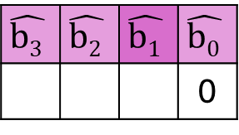
Hamming Code
Assuming the sequence 2B1₁₆ is received, calculate the control bits
12 | 11 | 10 | 9 | 8 | 7 | 6 | 5 | 4 | 3 | 2 | 1
0 | 0 | 1 | 0 | 1 | 0 | 1 | 1 | 0 | 0 | 0 | 1
 | 📌 |  | 📌 |  | 📌 |  | 📌 |  | 📌 |  | 📌
 | 📌 | 📌 |  |  | 📌 | 📌 |  |  | 📌 | 📌
📌 |  |  |  |  | 📌 | 📌 | 📌 | 📌
📌 | 📌 | 📌 | 📌 | 📌
$$\hat{{\text{b}}_{\text{3}}}$$ | $$\hat{{\text{b}}_{\text{2}}}$$ | $$\hat{{\text{b}}_{\text{1}}}$$ | $$\hat{{\text{b}}_{\text{0}}}$$
 |  |  | 0
⚠️

Slide 42
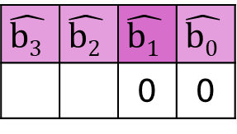
Hamming Code
Assuming the sequence 2B1₁₆ is received, calculate the control bits
12 | 11 | 10 | 9 | 8 | 7 | 6 | 5 | 4 | 3 | 2 | 1
0 | 0 | 1 | 0 | 1 | 0 | 1 | 1 | 0 | 0 | 0 | 1
 | 📌 |  | 📌 |  | 📌 |  | 📌 |  | 📌 |  | 📌
 | 📌 | 📌 |  |  | 📌 | 📌 |  |  | 📌 | 📌
📌 |  |  |  |  | 📌 | 📌 | 📌 | 📌
📌 | 📌 | 📌 | 📌 | 📌
$$\hat{{\text{b}}_{\text{3}}}$$ | $$\hat{{\text{b}}_{\text{2}}}$$ | $$\hat{{\text{b}}_{\text{1}}}$$ | $$\hat{{\text{b}}_{\text{0}}}$$
 |  | 0 | 0
⚠️

Slide 43
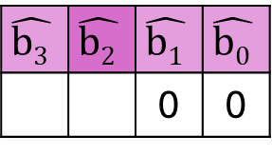
Hamming Code
Assuming the sequence 2B1₁₆ is received, calculate the control bits
12 | 11 | 10 | 9 | 8 | 7 | 6 | 5 | 4 | 3 | 2 | 1
0 | 0 | 1 | 0 | 1 | 0 | 1 | 1 | 0 | 0 | 0 | 1
 | 📌 |  | 📌 |  | 📌 |  | 📌 |  | 📌 |  | 📌
 | 📌 | 📌 |  |  | 📌 | 📌 |  |  | 📌 | 📌
📌 |  |  |  |  | 📌 | 📌 | 📌 | 📌
📌 | 📌 | 📌 | 📌 | 📌
$$\hat{{\text{b}}_{\text{3}}}$$ | $$\hat{{\text{b}}_{\text{2}}}$$ | $$\hat{{\text{b}}_{\text{1}}}$$ | $$\hat{{\text{b}}_{\text{0}}}$$
 |  | 0 | 0
⚠️

Slide 44
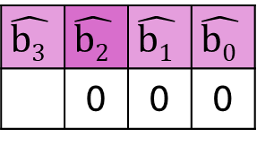
Hamming Code
Assuming the sequence 2B1₁₆ is received, calculate the control bits
12 | 11 | 10 | 9 | 8 | 7 | 6 | 5 | 4 | 3 | 2 | 1
0 | 0 | 1 | 0 | 1 | 0 | 1 | 1 | 0 | 0 | 0 | 1
 | 📌 |  | 📌 |  | 📌 |  | 📌 |  | 📌 |  | 📌
 | 📌 | 📌 |  |  | 📌 | 📌 |  |  | 📌 | 📌
📌 |  |  |  |  | 📌 | 📌 | 📌 | 📌
📌 | 📌 | 📌 | 📌 | 📌
$$\hat{{\text{b}}_{\text{3}}}$$ | $$\hat{{\text{b}}_{\text{2}}}$$ | $$\hat{{\text{b}}_{\text{1}}}$$ | $$\hat{{\text{b}}_{\text{0}}}$$
 | 0 | 0 | 0
⚠️

Slide 45
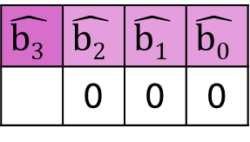
Hamming Code
Assuming the sequence 2B1₁₆ is received, calculate the control bits
12 | 11 | 10 | 9 | 8 | 7 | 6 | 5 | 4 | 3 | 2 | 1
0 | 0 | 1 | 0 | 1 | 0 | 1 | 1 | 0 | 0 | 0 | 1
 | 📌 |  | 📌 |  | 📌 |  | 📌 |  | 📌 |  | 📌
 | 📌 | 📌 |  |  | 📌 | 📌 |  |  | 📌 | 📌
📌 |  |  |  |  | 📌 | 📌 | 📌 | 📌
📌 | 📌 | 📌 | 📌 | 📌
$$\hat{{\text{b}}_{\text{3}}}$$ | $$\hat{{\text{b}}_{\text{2}}}$$ | $$\hat{{\text{b}}_{\text{1}}}$$ | $$\hat{{\text{b}}_{\text{0}}}$$
 | 0 | 0 | 0
⚠️

Slide 46
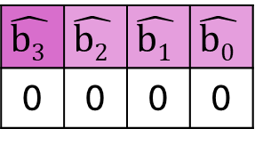
Hamming Code
Assuming the sequence 2B1₁₆ is received, calculate the control bits
12 | 11 | 10 | 9 | 8 | 7 | 6 | 5 | 4 | 3 | 2 | 1
0 | 0 | 1 | 0 | 1 | 0 | 1 | 1 | 0 | 0 | 0 | 1
 | 📌 |  | 📌 |  | 📌 |  | 📌 |  | 📌 |  | 📌
 | 📌 | 📌 |  |  | 📌 | 📌 |  |  | 📌 | 📌
📌 |  |  |  |  | 📌 | 📌 | 📌 | 📌
📌 | 📌 | 📌 | 📌 | 📌
$$\hat{{\text{b}}_{\text{3}}}$$ | $$\hat{{\text{b}}_{\text{2}}}$$ | $$\hat{{\text{b}}_{\text{1}}}$$ | $$\hat{{\text{b}}_{\text{0}}}$$
0 | 0 | 0 | 0
⚠️

Slide 47
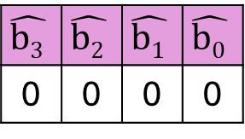
Hamming Code
Assuming the sequence 2B12B5₁₆ is received, calculate the control bits
12 | 11 | 10 | 9 | 8 | 7 | 6 | 5 | 4 | 3 | 2 | 1
0 | 0 | 1 | 0 | 1 | 0 | 1 | 1 | 0 | 0 | 0 | 1
 | 📌 |  | 📌 |  | 📌 |  | 📌 |  | 📌 |  | 📌
 | 📌 | 📌 |  |  | 📌 | 📌 |  |  | 📌 | 📌
📌 |  |  |  |  | 📌 | 📌 | 📌 | 📌
📌 | 📌 | 📌 | 📌 | 📌
$$\hat{{\text{b}}_{\text{3}}}$$ | $$\hat{{\text{b}}_{\text{2}}}$$ | $$\hat{{\text{b}}_{\text{1}}}$$ | $$\hat{{\text{b}}_{\text{0}}}$$
0 | 0 | 0 | 0
⚠️

Slide 48
Hamming Code
Assuming the sequence 2B12B5₁₆ is received, calculate the control bits
12 | 11 | 10 | 9 | 8 | 7 | 6 | 5 | 4 | 3 | 2 | 1
0 | 0 | 1 | 0 | 1 | 0 | 1 | 1 | 0 | 1 | 0 | 1
 | 📌 |  | 📌 |  | 📌 |  | 📌 |  | 📌 |  | 📌
 | 📌 | 📌 |  |  | 📌 | 📌 |  |  | 📌 | 📌
📌 |  |  |  |  | 📌 | 📌 | 📌 | 📌
📌 | 📌 | 📌 | 📌 | 📌
$$\hat{{\text{b}}_{\text{3}}}$$ | $$\hat{{\text{b}}_{\text{2}}}$$ | $$\hat{{\text{b}}_{\text{1}}}$$ | $$\hat{{\text{b}}_{\text{0}}}$$
0 | 0 | 0 | 0
⚠️

Slide 49
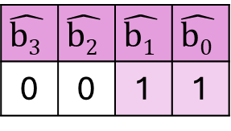
Hamming Code
Assuming the sequence 2B12B5₁₆ is received, calculate the control bits
12 | 11 | 10 | 9 | 8 | 7 | 6 | 5 | 4 | 3 | 2 | 1
0 | 0 | 1 | 0 | 1 | 0 | 1 | 1 | 0 | 1 | 0 | 1
 | 📌 |  | 📌 |  | 📌 |  | 📌 |  | 📌 |  | 📌
 | 📌 | 📌 |  |  | 📌 | 📌 |  |  | 📌 | 📌
📌 |  |  |  |  | 📌 | 📌 | 📌 | 📌
📌 | 📌 | 📌 | 📌 | 📌
$$\hat{{\text{b}}_{\text{3}}}$$ | $$\hat{{\text{b}}_{\text{2}}}$$ | $$\hat{{\text{b}}_{\text{1}}}$$ | $$\hat{{\text{b}}_{\text{0}}}$$
0 | 0 | 1 | 1
⚠️

Slide 50
Hamming Code
Assuming the sequence 2B12B5₁₆ is received, calculate the control bits
12 | 11 | 10 | 9 | 8 | 7 | 6 | 5 | 4 | 3 | 2 | 1
0 | 0 | 1 | 0 | 1 | 0 | 1 | 1 | 0 | 1 | 0 | 1
 | 📌 |  | 📌 |  | 📌 |  | 📌 |  | 📌 |  | 📌
 | 📌 | 📌 |  |  | 📌 | 📌 |  |  | 📌 | 📌
📌 |  |  |  |  | 📌 | 📌 | 📌 | 📌
📌 | 📌 | 📌 | 📌 | 📌
$$\hat{{\text{b}}_{\text{3}}}$$ | $$\hat{{\text{b}}_{\text{2}}}$$ | $$\hat{{\text{b}}_{\text{1}}}$$ | $$\hat{{\text{b}}_{\text{0}}}$$
0 | 0 | 1 | 1
⚠️

Slide 51
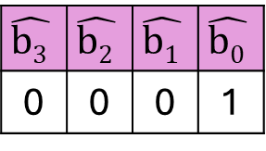
Hamming Code
Assuming the sequence 2D1₁₆ is received, calculate the control bits
12 | 11 | 10 | 9 | 8 | 7 | 6 | 5 | 4 | 3 | 2 | 1
0 | 0 | 1 | 0 | 1 | 1 | 0 | 1 | 0 | 0 | 0 | 1
 | 📌 |  | 📌 |  | 📌 |  | 📌 |  | 📌 |  | 📌
 | 📌 | 📌 |  |  | 📌 | 📌 |  |  | 📌 | 📌
📌 |  |  |  |  | 📌 | 📌 | 📌 | 📌
📌 | 📌 | 📌 | 📌 | 📌
$$\hat{{\text{b}}_{\text{3}}}$$ | $$\hat{{\text{b}}_{\text{2}}}$$ | $$\hat{{\text{b}}_{\text{1}}}$$ | $$\hat{{\text{b}}_{\text{0}}}$$
0 | 0 | 0 | 1
⚠️

Slide 52

Truth Tables
$$\text{Y}\text{ =} \text{(}\text{A}\text{+}\text{B}\text{+}\text{C}\text{)}∙\text{(}\text{A}\text{+}\text{B}\text{+}\overline{\text{C}}\text{) + }\text{A}$$
A | B | C | Y

Slide 53
Truth Tables
$$\text{Y}\text{ =} \text{(}\text{A}\text{+}\text{B}\text{+}\text{C}\text{)}∙\text{(}\text{A}\text{+}\text{B}\text{+}\overline{\text{C}}\text{) + }\text{A}$$
A | B | C | Y
0 | 0 | 0
0 | 0 | 1
0 | 1 | 0
0 | 1 | 1
1 | 0 | 0
1 | 0 | 1
1 | 1 | 0
1 | 1 | 1

Slide 54
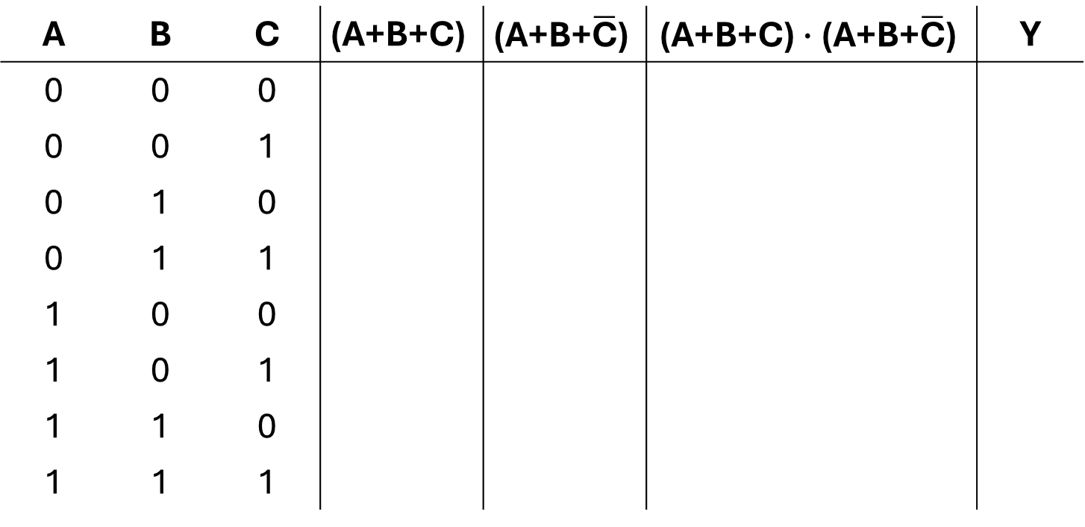
Truth Tables
$$\text{Y}\text{ =} \text{(}\text{A}\text{+}\text{B}\text{+}\text{C}\text{)}∙\text{(}\text{A}\text{+}\text{B}\text{+}\overline{\text{C}}\text{) + }\text{A}$$
A | B | C | $$\text{(}\text{A}\text{+}\text{B}\text{+}\text{C}\text{)}$$ | $$\text{(}\text{A}\text{+}\text{B}\text{+}\overline{\text{C}}\text{)}$$ | $$\text{(}\text{A}\text{+}\text{B}\text{+}\text{C}\text{)}∙\text{(}\text{A}\text{+}\text{B}\text{+}\overline{\text{C}}\text{)}$$ | Y
0 | 0 | 0
0 | 0 | 1
0 | 1 | 0
0 | 1 | 1
1 | 0 | 0
1 | 0 | 1
1 | 1 | 0
1 | 1 | 1

Slide 55
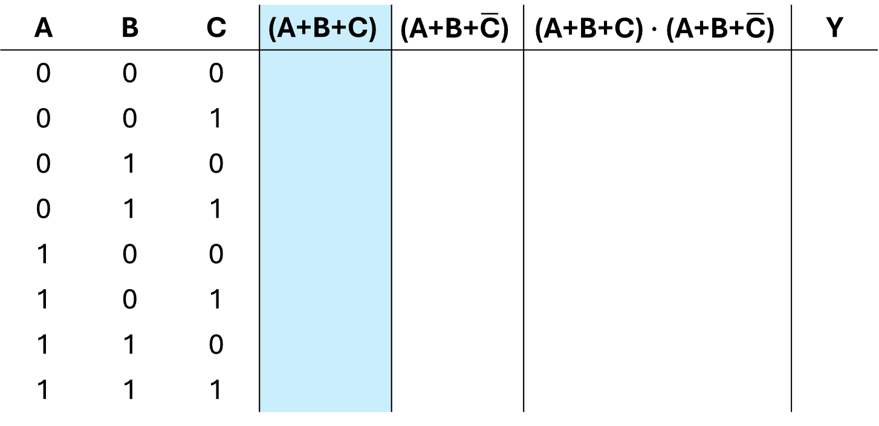
Truth Tables
$$\text{Y}\text{ =} \text{(}\text{A}\text{+}\text{B}\text{+}\text{C}\text{)}∙\text{(}\text{A}\text{+}\text{B}\text{+}\overline{\text{C}}\text{) + }\text{A}$$
A | B | C | $$\text{(}\text{A}\text{+}\text{B}\text{+}\text{C}\text{)}$$ | $$\text{(}\text{A}\text{+}\text{B}\text{+}\overline{\text{C}}\text{)}$$ | $$\text{(}\text{A}\text{+}\text{B}\text{+}\text{C}\text{)}∙\text{(}\text{A}\text{+}\text{B}\text{+}\overline{\text{C}}\text{)}$$ | Y
0 | 0 | 0
0 | 0 | 1
0 | 1 | 0
0 | 1 | 1
1 | 0 | 0
1 | 0 | 1
1 | 1 | 0
1 | 1 | 1

Slide 56
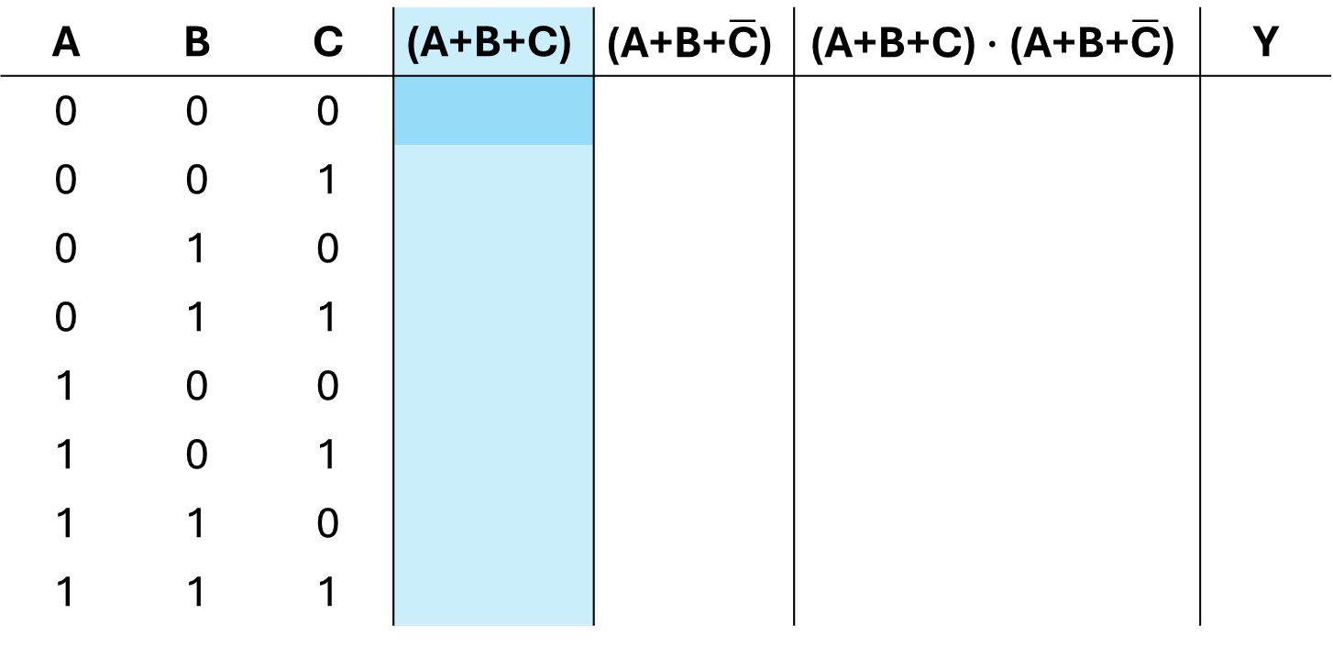
Truth Tables
$$\text{Y}\text{ =} \text{(}\text{A}\text{+}\text{B}\text{+}\text{C}\text{)}∙\text{(}\text{A}\text{+}\text{B}\text{+}\overline{\text{C}}\text{) + }\text{A}$$
A | B | C | $$\text{(}\text{A}\text{+}\text{B}\text{+}\text{C}\text{)}$$ | $$\text{(}\text{A}\text{+}\text{B}\text{+}\overline{\text{C}}\text{)}$$ | $$\text{(}\text{A}\text{+}\text{B}\text{+}\text{C}\text{)}∙\text{(}\text{A}\text{+}\text{B}\text{+}\overline{\text{C}}\text{)}$$ | Y
0 | 0 | 0
0 | 0 | 1
0 | 1 | 0
0 | 1 | 1
1 | 0 | 0
1 | 0 | 1
1 | 1 | 0
1 | 1 | 1

Slide 57
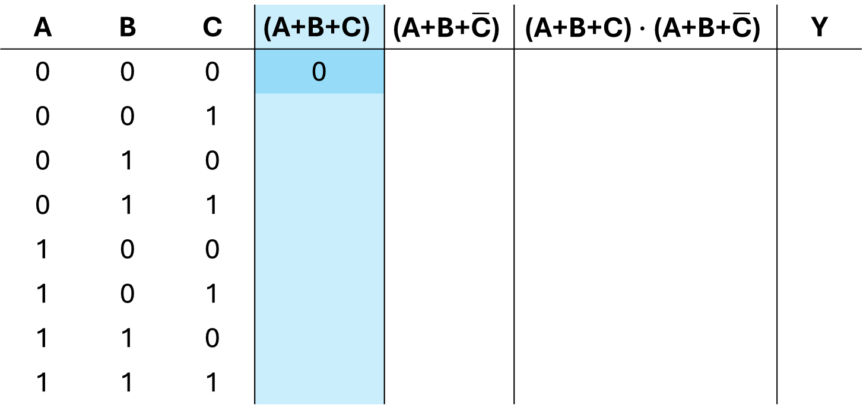
Truth Tables
$$\text{Y}\text{ =} \text{(}\text{A}\text{+}\text{B}\text{+}\text{C}\text{)}∙\text{(}\text{A}\text{+}\text{B}\text{+}\overline{\text{C}}\text{) + }\text{A}$$
A | B | C | $$\text{(}\text{A}\text{+}\text{B}\text{+}\text{C}\text{)}$$ | $$\text{(}\text{A}\text{+}\text{B}\text{+}\overline{\text{C}}\text{)}$$ | $$\text{(}\text{A}\text{+}\text{B}\text{+}\text{C}\text{)}∙\text{(}\text{A}\text{+}\text{B}\text{+}\overline{\text{C}}\text{)}$$ | Y
0 | 0 | 0 | 0
0 | 0 | 1
0 | 1 | 0
0 | 1 | 1
1 | 0 | 0
1 | 0 | 1
1 | 1 | 0
1 | 1 | 1

Slide 58
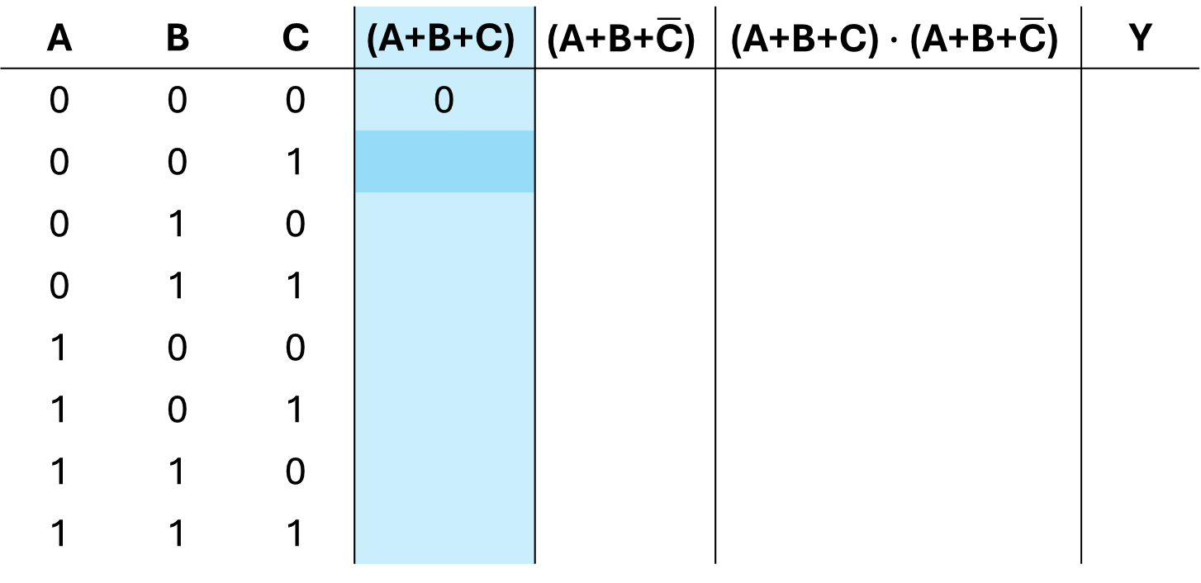
Truth Tables
$$\text{Y}\text{ =} \text{(}\text{A}\text{+}\text{B}\text{+}\text{C}\text{)}∙\text{(}\text{A}\text{+}\text{B}\text{+}\overline{\text{C}}\text{) + }\text{A}$$
A | B | C | $$\text{(}\text{A}\text{+}\text{B}\text{+}\text{C}\text{)}$$ | $$\text{(}\text{A}\text{+}\text{B}\text{+}\overline{\text{C}}\text{)}$$ | $$\text{(}\text{A}\text{+}\text{B}\text{+}\text{C}\text{)}∙\text{(}\text{A}\text{+}\text{B}\text{+}\overline{\text{C}}\text{)}$$ | Y
0 | 0 | 0 | 0
0 | 0 | 1
0 | 1 | 0
0 | 1 | 1
1 | 0 | 0
1 | 0 | 1
1 | 1 | 0
1 | 1 | 1

Slide 59

Truth Tables
$$\text{Y}\text{ =} \text{(}\text{A}\text{+}\text{B}\text{+}\text{C}\text{)}∙\text{(}\text{A}\text{+}\text{B}\text{+}\overline{\text{C}}\text{) + }\text{A}$$
A | B | C | $$\text{(}\text{A}\text{+}\text{B}\text{+}\text{C}\text{)}$$ | $$\text{(}\text{A}\text{+}\text{B}\text{+}\overline{\text{C}}\text{)}$$ | $$\text{(}\text{A}\text{+}\text{B}\text{+}\text{C}\text{)}∙\text{(}\text{A}\text{+}\text{B}\text{+}\overline{\text{C}}\text{)}$$ | Y
0 | 0 | 0 | 0
0 | 0 | 1 | 1
0 | 1 | 0
0 | 1 | 1
1 | 0 | 0
1 | 0 | 1
1 | 1 | 0
1 | 1 | 1

Slide 60
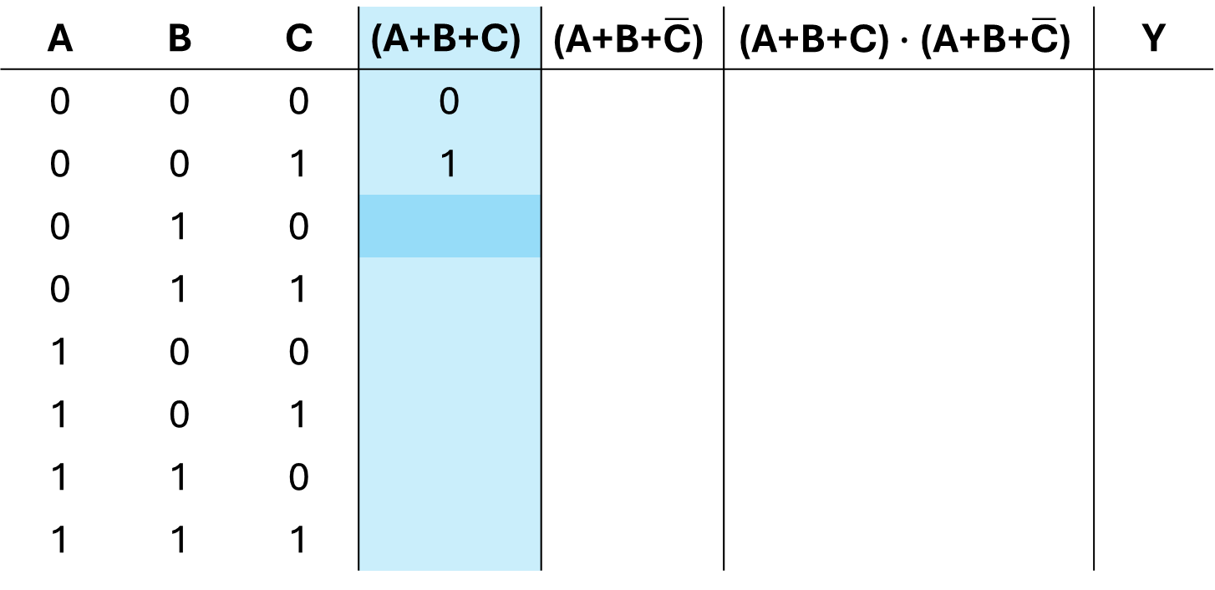
Truth Tables
$$\text{Y}\text{ =} \text{(}\text{A}\text{+}\text{B}\text{+}\text{C}\text{)}∙\text{(}\text{A}\text{+}\text{B}\text{+}\overline{\text{C}}\text{) + }\text{A}$$
A | B | C | $$\text{(}\text{A}\text{+}\text{B}\text{+}\text{C}\text{)}$$ | $$\text{(}\text{A}\text{+}\text{B}\text{+}\overline{\text{C}}\text{)}$$ | $$\text{(}\text{A}\text{+}\text{B}\text{+}\text{C}\text{)}∙\text{(}\text{A}\text{+}\text{B}\text{+}\overline{\text{C}}\text{)}$$ | Y
0 | 0 | 0 | 0
0 | 0 | 1 | 1
0 | 1 | 0
0 | 1 | 1
1 | 0 | 0
1 | 0 | 1
1 | 1 | 0
1 | 1 | 1

Slide 61

Truth Tables
$$\text{Y}\text{ =} \text{(}\text{A}\text{+}\text{B}\text{+}\text{C}\text{)}∙\text{(}\text{A}\text{+}\text{B}\text{+}\overline{\text{C}}\text{) + }\text{A}$$
A | B | C | $$\text{(}\text{A}\text{+}\text{B}\text{+}\text{C}\text{)}$$ | $$\text{(}\text{A}\text{+}\text{B}\text{+}\overline{\text{C}}\text{)}$$ | $$\text{(}\text{A}\text{+}\text{B}\text{+}\text{C}\text{)}∙\text{(}\text{A}\text{+}\text{B}\text{+}\overline{\text{C}}\text{)}$$ | Y
0 | 0 | 0 | 0
0 | 0 | 1 | 1
0 | 1 | 0 | 1
0 | 1 | 1
1 | 0 | 0
1 | 0 | 1
1 | 1 | 0
1 | 1 | 1

Slide 62
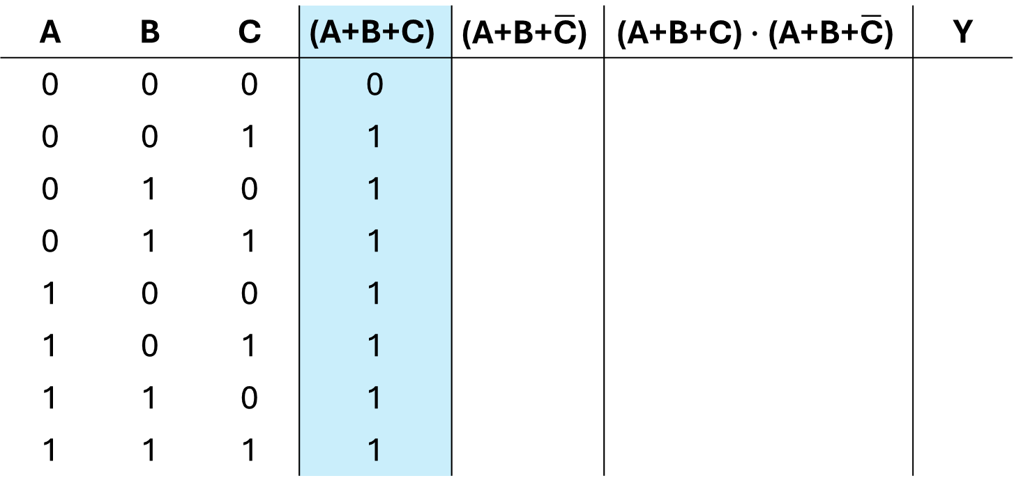
Truth Tables
$$\text{Y}\text{ =} \text{(}\text{A}\text{+}\text{B}\text{+}\text{C}\text{)}∙\text{(}\text{A}\text{+}\text{B}\text{+}\overline{\text{C}}\text{) + }\text{A}$$
A | B | C | $$\text{(}\text{A}\text{+}\text{B}\text{+}\text{C}\text{)}$$ | $$\text{(}\text{A}\text{+}\text{B}\text{+}\overline{\text{C}}\text{)}$$ | $$\text{(}\text{A}\text{+}\text{B}\text{+}\text{C}\text{)}∙\text{(}\text{A}\text{+}\text{B}\text{+}\overline{\text{C}}\text{)}$$ | Y
0 | 0 | 0 | 0
0 | 0 | 1 | 1
0 | 1 | 0 | 1
0 | 1 | 1 | 1
1 | 0 | 0 | 1
1 | 0 | 1 | 1
1 | 1 | 0 | 1
1 | 1 | 1 | 1

Slide 63
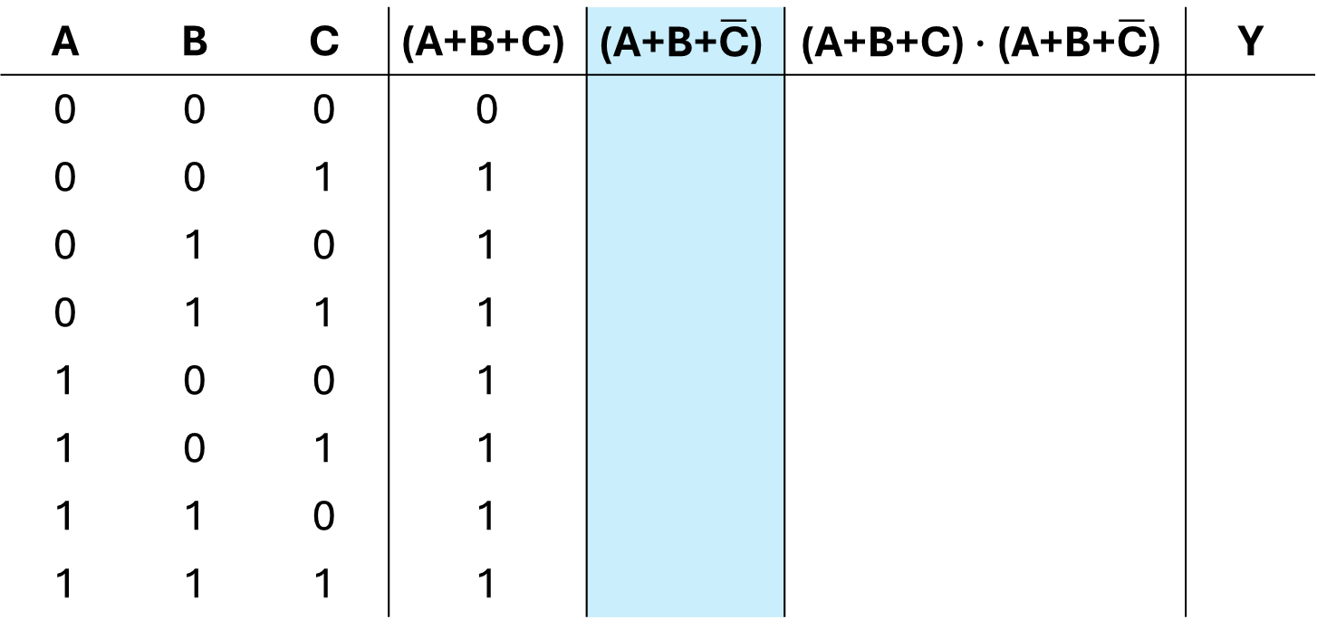
Truth Tables
$$\text{Y}\text{ =} \text{(}\text{A}\text{+}\text{B}\text{+}\text{C}\text{)}∙\text{(}\text{A}\text{+}\text{B}\text{+}\overline{\text{C}}\text{) + }\text{A}$$
A | B | C | $$\text{(}\text{A}\text{+}\text{B}\text{+}\text{C}\text{)}$$ | $$\text{(}\text{A}\text{+}\text{B}\text{+}\overline{\text{C}}\text{)}$$ | $$\text{(}\text{A}\text{+}\text{B}\text{+}\text{C}\text{)}∙\text{(}\text{A}\text{+}\text{B}\text{+}\overline{\text{C}}\text{)}$$ | Y
0 | 0 | 0 | 0
0 | 0 | 1 | 1
0 | 1 | 0 | 1
0 | 1 | 1 | 1
1 | 0 | 0 | 1
1 | 0 | 1 | 1
1 | 1 | 0 | 1
1 | 1 | 1 | 1

Slide 64
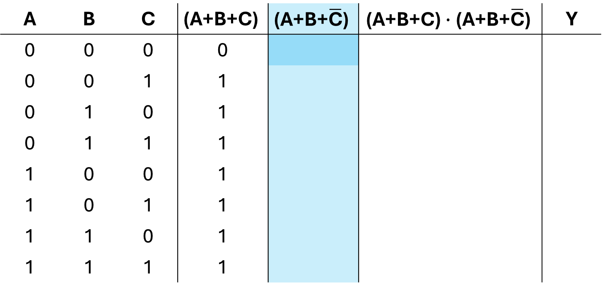
Truth Tables
$$\text{Y}\text{ =} \text{(}\text{A}\text{+}\text{B}\text{+}\text{C}\text{)}∙\text{(}\text{A}\text{+}\text{B}\text{+}\overline{\text{C}}\text{) + }\text{A}$$
A | B | C | $$\text{(}\text{A}\text{+}\text{B}\text{+}\text{C}\text{)}$$ | $$\text{(}\text{A}\text{+}\text{B}\text{+}\overline{\text{C}}\text{)}$$ | $$\text{(}\text{A}\text{+}\text{B}\text{+}\text{C}\text{)}∙\text{(}\text{A}\text{+}\text{B}\text{+}\overline{\text{C}}\text{)}$$ | Y
0 | 0 | 0 | 0
0 | 0 | 1 | 1
0 | 1 | 0 | 1
0 | 1 | 1 | 1
1 | 0 | 0 | 1
1 | 0 | 1 | 1
1 | 1 | 0 | 1
1 | 1 | 1 | 1

Slide 65
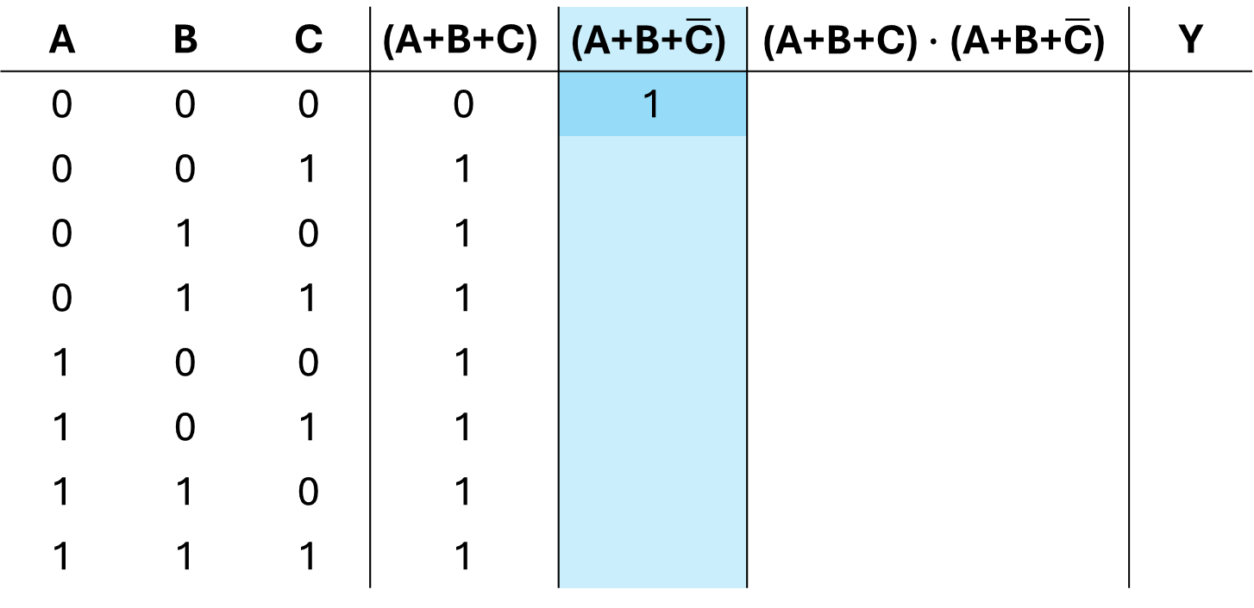
Truth Tables
$$\text{Y}\text{ =} \text{(}\text{A}\text{+}\text{B}\text{+}\text{C}\text{)}∙\text{(}\text{A}\text{+}\text{B}\text{+}\overline{\text{C}}\text{) + }\text{A}$$
A | B | C | $$\text{(}\text{A}\text{+}\text{B}\text{+}\text{C}\text{)}$$ | $$\text{(}\text{A}\text{+}\text{B}\text{+}\overline{\text{C}}\text{)}$$ | $$\text{(}\text{A}\text{+}\text{B}\text{+}\text{C}\text{)}∙\text{(}\text{A}\text{+}\text{B}\text{+}\overline{\text{C}}\text{)}$$ | Y
0 | 0 | 0 | 0 | 1
0 | 0 | 1 | 1
0 | 1 | 0 | 1
0 | 1 | 1 | 1
1 | 0 | 0 | 1
1 | 0 | 1 | 1
1 | 1 | 0 | 1
1 | 1 | 1 | 1

Slide 66
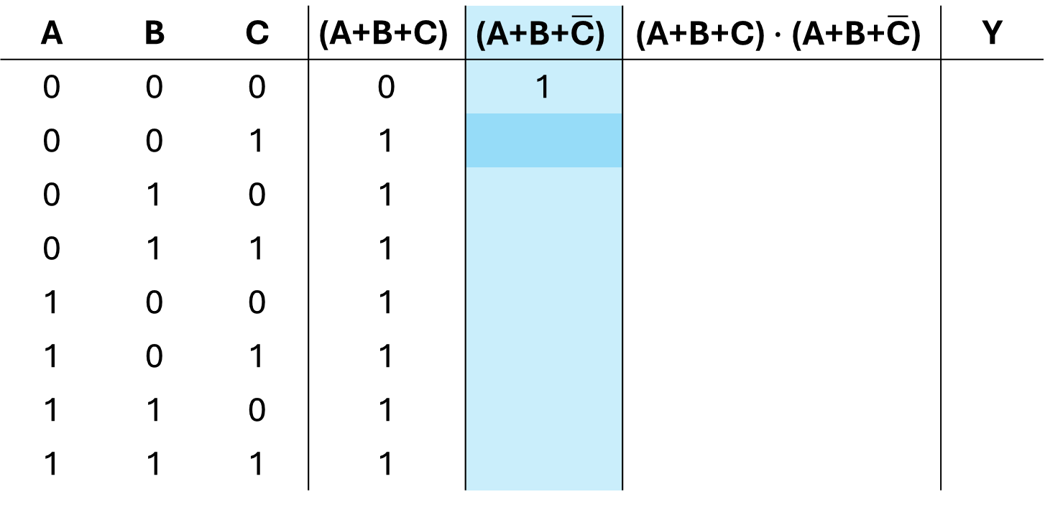
Truth Tables
$$\text{Y}\text{ =} \text{(}\text{A}\text{+}\text{B}\text{+}\text{C}\text{)}∙\text{(}\text{A}\text{+}\text{B}\text{+}\overline{\text{C}}\text{) + }\text{A}$$
A | B | C | $$\text{(}\text{A}\text{+}\text{B}\text{+}\text{C}\text{)}$$ | $$\text{(}\text{A}\text{+}\text{B}\text{+}\overline{\text{C}}\text{)}$$ | $$\text{(}\text{A}\text{+}\text{B}\text{+}\text{C}\text{)}∙\text{(}\text{A}\text{+}\text{B}\text{+}\overline{\text{C}}\text{)}$$ | Y
0 | 0 | 0 | 0 | 1
0 | 0 | 1 | 1
0 | 1 | 0 | 1
0 | 1 | 1 | 1
1 | 0 | 0 | 1
1 | 0 | 1 | 1
1 | 1 | 0 | 1
1 | 1 | 1 | 1

Slide 67
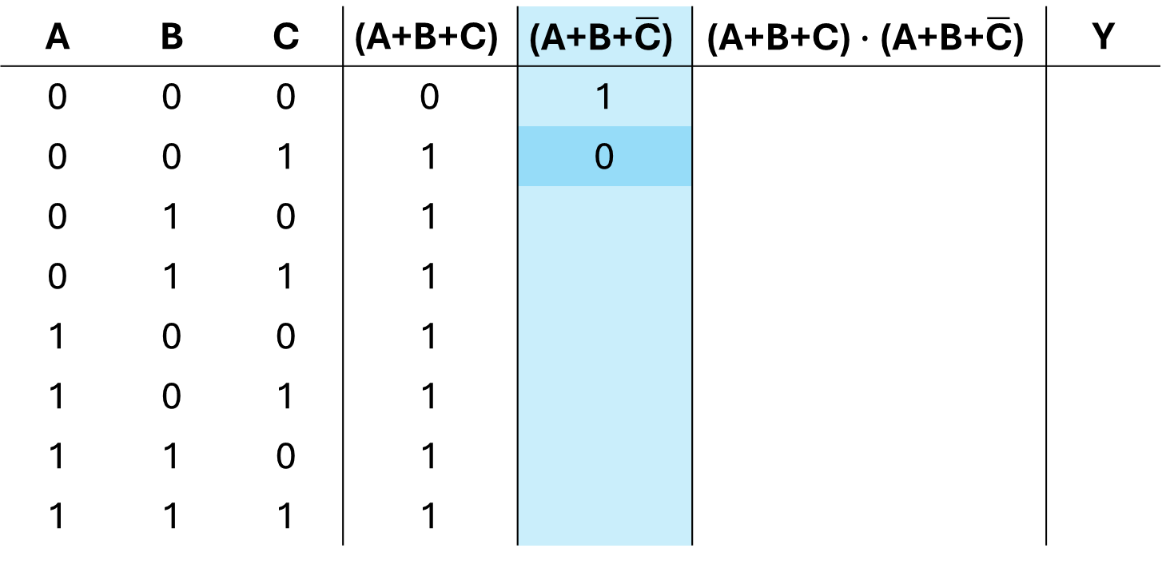
Truth Tables
$$\text{Y}\text{ =} \text{(}\text{A}\text{+}\text{B}\text{+}\text{C}\text{)}∙\text{(}\text{A}\text{+}\text{B}\text{+}\overline{\text{C}}\text{) + }\text{A}$$
A | B | C | $$\text{(}\text{A}\text{+}\text{B}\text{+}\text{C}\text{)}$$ | $$\text{(}\text{A}\text{+}\text{B}\text{+}\overline{\text{C}}\text{)}$$ | $$\text{(}\text{A}\text{+}\text{B}\text{+}\text{C}\text{)}∙\text{(}\text{A}\text{+}\text{B}\text{+}\overline{\text{C}}\text{)}$$ | Y
0 | 0 | 0 | 0 | 1
0 | 0 | 1 | 1 | 0
0 | 1 | 0 | 1
0 | 1 | 1 | 1
1 | 0 | 0 | 1
1 | 0 | 1 | 1
1 | 1 | 0 | 1
1 | 1 | 1 | 1

Slide 68
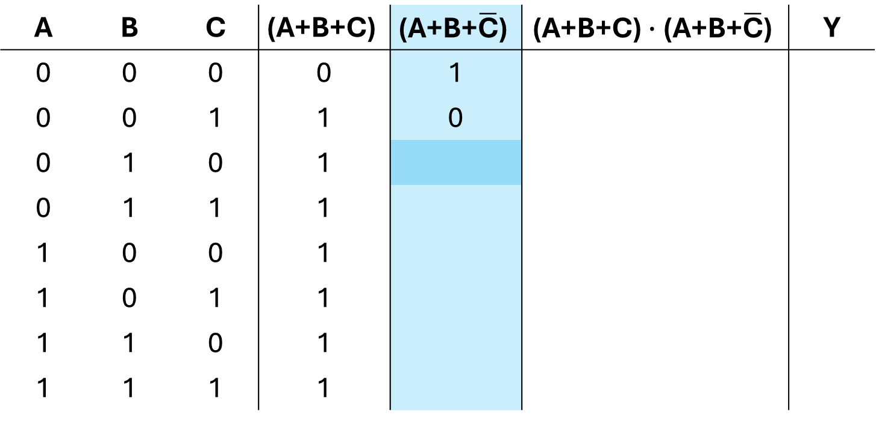
Truth Tables
$$\text{Y}\text{ =} \text{(}\text{A}\text{+}\text{B}\text{+}\text{C}\text{)}∙\text{(}\text{A}\text{+}\text{B}\text{+}\overline{\text{C}}\text{) + }\text{A}$$
A | B | C | $$\text{(}\text{A}\text{+}\text{B}\text{+}\text{C}\text{)}$$ | $$\text{(}\text{A}\text{+}\text{B}\text{+}\overline{\text{C}}\text{)}$$ | $$\text{(}\text{A}\text{+}\text{B}\text{+}\text{C}\text{)}∙\text{(}\text{A}\text{+}\text{B}\text{+}\overline{\text{C}}\text{)}$$ | Y
0 | 0 | 0 | 0 | 1
0 | 0 | 1 | 1 | 0
0 | 1 | 0 | 1
0 | 1 | 1 | 1
1 | 0 | 0 | 1
1 | 0 | 1 | 1
1 | 1 | 0 | 1
1 | 1 | 1 | 1

Slide 69
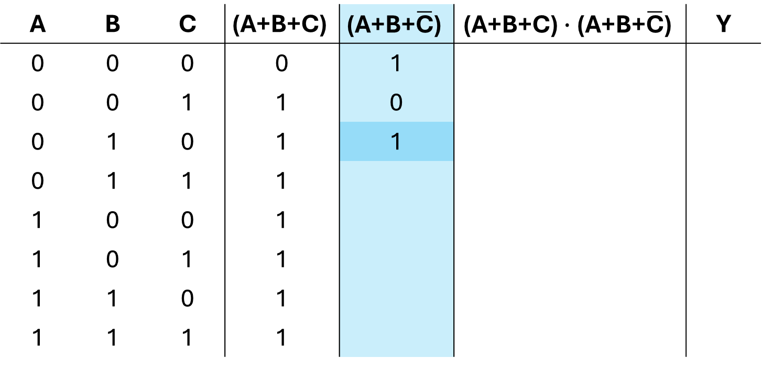
Truth Tables
$$\text{Y}\text{ =} \text{(}\text{A}\text{+}\text{B}\text{+}\text{C}\text{)}∙\text{(}\text{A}\text{+}\text{B}\text{+}\overline{\text{C}}\text{) + }\text{A}$$
A | B | C | $$\text{(}\text{A}\text{+}\text{B}\text{+}\text{C}\text{)}$$ | $$\text{(}\text{A}\text{+}\text{B}\text{+}\overline{\text{C}}\text{)}$$ | $$\text{(}\text{A}\text{+}\text{B}\text{+}\text{C}\text{)}∙\text{(}\text{A}\text{+}\text{B}\text{+}\overline{\text{C}}\text{)}$$ | Y
0 | 0 | 0 | 0 | 1
0 | 0 | 1 | 1 | 0
0 | 1 | 0 | 1 | 1
0 | 1 | 1 | 1
1 | 0 | 0 | 1
1 | 0 | 1 | 1
1 | 1 | 0 | 1
1 | 1 | 1 | 1

Slide 70
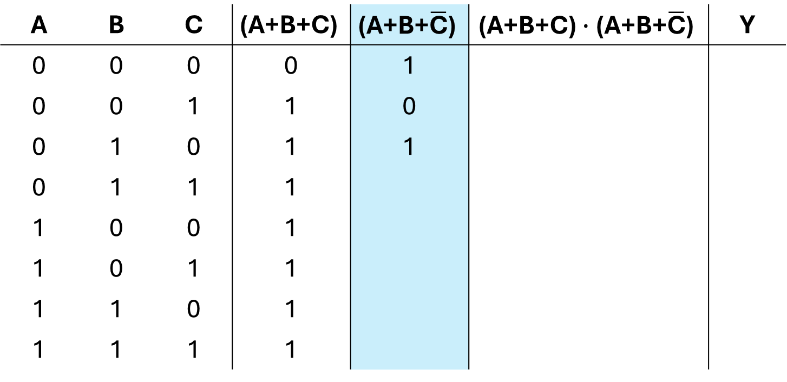
Truth Tables
$$\text{Y}\text{ =} \text{(}\text{A}\text{+}\text{B}\text{+}\text{C}\text{)}∙\text{(}\text{A}\text{+}\text{B}\text{+}\overline{\text{C}}\text{) + }\text{A}$$
A | B | C | $$\text{(}\text{A}\text{+}\text{B}\text{+}\text{C}\text{)}$$ | $$\text{(}\text{A}\text{+}\text{B}\text{+}\overline{\text{C}}\text{)}$$ | $$\text{(}\text{A}\text{+}\text{B}\text{+}\text{C}\text{)}∙\text{(}\text{A}\text{+}\text{B}\text{+}\overline{\text{C}}\text{)}$$ | Y
0 | 0 | 0 | 0 | 1
0 | 0 | 1 | 1 | 0
0 | 1 | 0 | 1 | 1
0 | 1 | 1 | 1
1 | 0 | 0 | 1
1 | 0 | 1 | 1
1 | 1 | 0 | 1
1 | 1 | 1 | 1

Slide 71
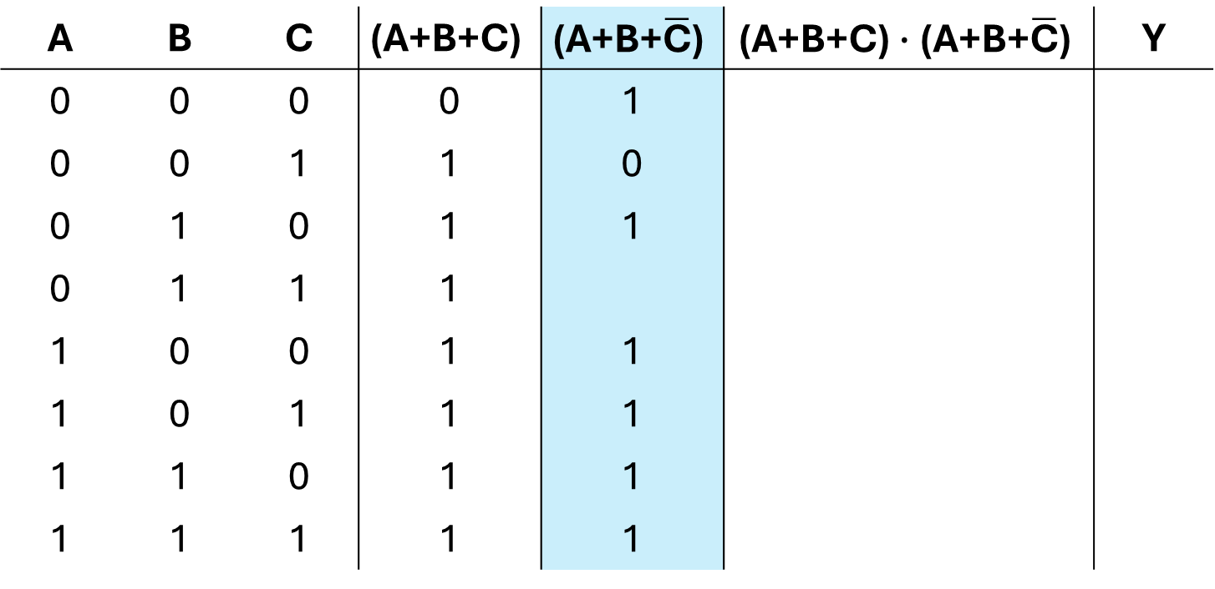
Truth Tables
$$\text{Y}\text{ =} \text{(}\text{A}\text{+}\text{B}\text{+}\text{C}\text{)}∙\text{(}\text{A}\text{+}\text{B}\text{+}\overline{\text{C}}\text{) + }\text{A}$$
A | B | C | $$\text{(}\text{A}\text{+}\text{B}\text{+}\text{C}\text{)}$$ | $$\text{(}\text{A}\text{+}\text{B}\text{+}\overline{\text{C}}\text{)}$$ | $$\text{(}\text{A}\text{+}\text{B}\text{+}\text{C}\text{)}∙\text{(}\text{A}\text{+}\text{B}\text{+}\overline{\text{C}}\text{)}$$ | Y
0 | 0 | 0 | 0 | 1
0 | 0 | 1 | 1 | 0
0 | 1 | 0 | 1 | 1
0 | 1 | 1 | 1
1 | 0 | 0 | 1 | 1
1 | 0 | 1 | 1 | 1
1 | 1 | 0 | 1 | 1
1 | 1 | 1 | 1 | 1

Slide 72

Truth Tables
$$\text{Y}\text{ =} \text{(}\text{A}\text{+}\text{B}\text{+}\text{C}\text{)}∙\text{(}\text{A}\text{+}\text{B}\text{+}\overline{\text{C}}\text{) + }\text{A}$$
A | B | C | $$\text{(}\text{A}\text{+}\text{B}\text{+}\text{C}\text{)}$$ | $$\text{(}\text{A}\text{+}\text{B}\text{+}\overline{\text{C}}\text{)}$$ | $$\text{(}\text{A}\text{+}\text{B}\text{+}\text{C}\text{)}∙\text{(}\text{A}\text{+}\text{B}\text{+}\overline{\text{C}}\text{)}$$ | Y
0 | 0 | 0 | 0 | 1
0 | 0 | 1 | 1 | 0
0 | 1 | 0 | 1 | 1
0 | 1 | 1 | 1 | 1
1 | 0 | 0 | 1 | 1
1 | 0 | 1 | 1 | 1
1 | 1 | 0 | 1 | 1
1 | 1 | 1 | 1 | 1

Slide 73
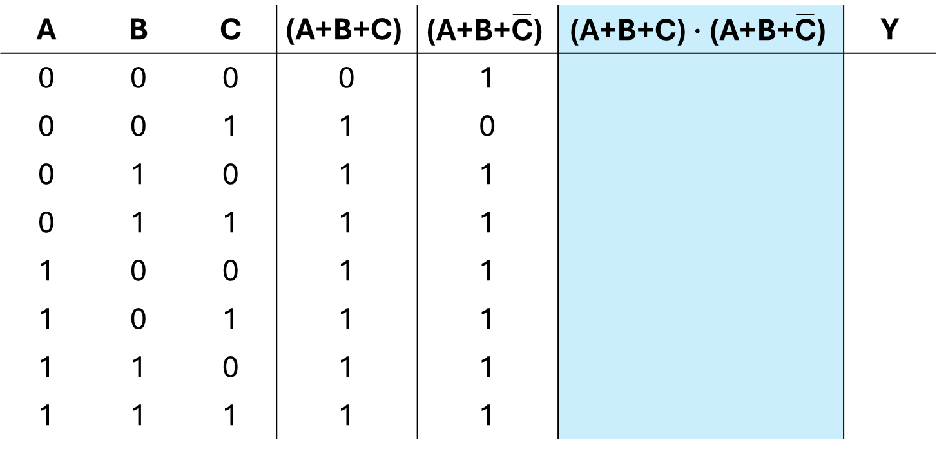
Truth Tables
$$\text{Y}\text{ =} \text{(}\text{A}\text{+}\text{B}\text{+}\text{C}\text{)}∙\text{(}\text{A}\text{+}\text{B}\text{+}\overline{\text{C}}\text{) + }\text{A}$$
A | B | C | $$\text{(}\text{A}\text{+}\text{B}\text{+}\text{C}\text{)}$$ | $$\text{(}\text{A}\text{+}\text{B}\text{+}\overline{\text{C}}\text{)}$$ | $$\text{(}\text{A}\text{+}\text{B}\text{+}\text{C}\text{)}∙\text{(}\text{A}\text{+}\text{B}\text{+}\overline{\text{C}}\text{)}$$ | Y
0 | 0 | 0 | 0 | 1
0 | 0 | 1 | 1 | 0
0 | 1 | 0 | 1 | 1
0 | 1 | 1 | 1 | 1
1 | 0 | 0 | 1 | 1
1 | 0 | 1 | 1 | 1
1 | 1 | 0 | 1 | 1
1 | 1 | 1 | 1 | 1

Slide 74
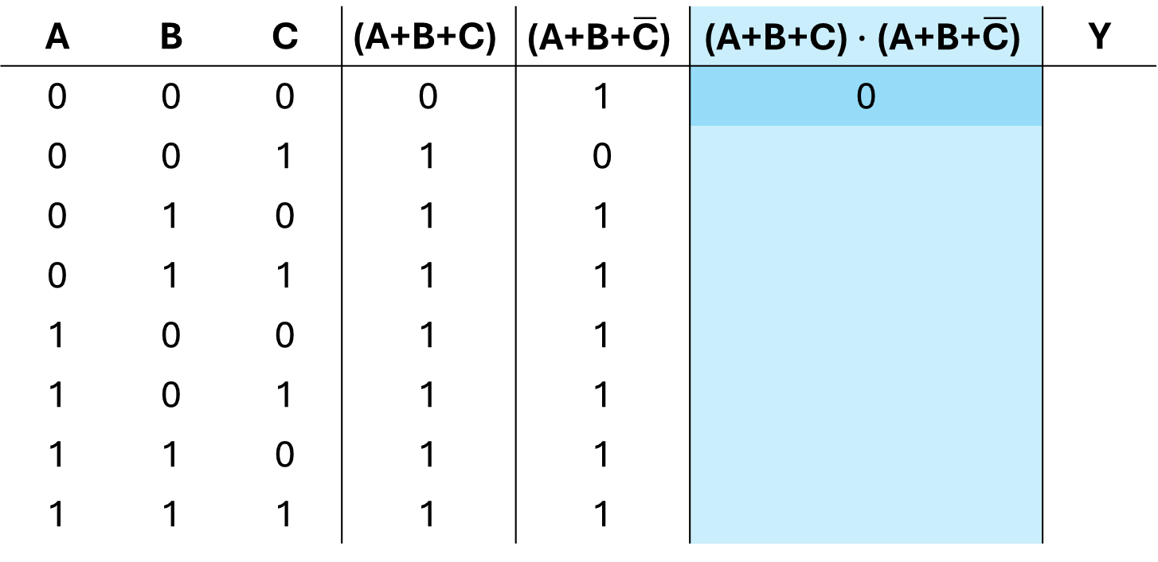
Truth Tables
$$\text{Y}\text{ =} \text{(}\text{A}\text{+}\text{B}\text{+}\text{C}\text{)}∙\text{(}\text{A}\text{+}\text{B}\text{+}\overline{\text{C}}\text{) + }\text{A}$$
A | B | C | $$\text{(}\text{A}\text{+}\text{B}\text{+}\text{C}\text{)}$$ | $$\text{(}\text{A}\text{+}\text{B}\text{+}\overline{\text{C}}\text{)}$$ | $$\text{(}\text{A}\text{+}\text{B}\text{+}\text{C}\text{)}∙\text{(}\text{A}\text{+}\text{B}\text{+}\overline{\text{C}}\text{)}$$ | Y
0 | 0 | 0 | 0 | 1 | 0
0 | 0 | 1 | 1 | 0
0 | 1 | 0 | 1 | 1
0 | 1 | 1 | 1 | 1
1 | 0 | 0 | 1 | 1
1 | 0 | 1 | 1 | 1
1 | 1 | 0 | 1 | 1
1 | 1 | 1 | 1 | 1

Slide 75
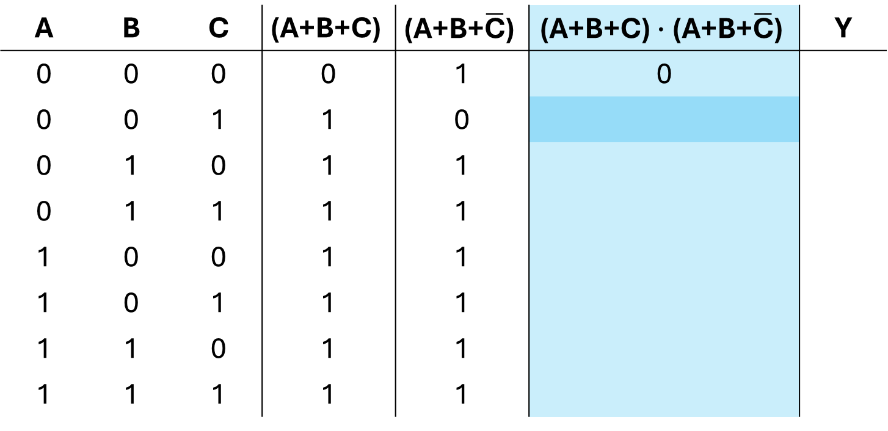
Truth Tables
$$\text{Y}\text{ =} \text{(}\text{A}\text{+}\text{B}\text{+}\text{C}\text{)}∙\text{(}\text{A}\text{+}\text{B}\text{+}\overline{\text{C}}\text{) + }\text{A}$$
A | B | C | $$\text{(}\text{A}\text{+}\text{B}\text{+}\text{C}\text{)}$$ | $$\text{(}\text{A}\text{+}\text{B}\text{+}\overline{\text{C}}\text{)}$$ | $$\text{(}\text{A}\text{+}\text{B}\text{+}\text{C}\text{)}∙\text{(}\text{A}\text{+}\text{B}\text{+}\overline{\text{C}}\text{)}$$ | Y
0 | 0 | 0 | 0 | 1 | 0
0 | 0 | 1 | 1 | 0
0 | 1 | 0 | 1 | 1
0 | 1 | 1 | 1 | 1
1 | 0 | 0 | 1 | 1
1 | 0 | 1 | 1 | 1
1 | 1 | 0 | 1 | 1
1 | 1 | 1 | 1 | 1

Slide 76

Truth Tables
$$\text{Y}\text{ =} \text{(}\text{A}\text{+}\text{B}\text{+}\text{C}\text{)}∙\text{(}\text{A}\text{+}\text{B}\text{+}\overline{\text{C}}\text{) + }\text{A}$$
A | B | C | $$\text{(}\text{A}\text{+}\text{B}\text{+}\text{C}\text{)}$$ | $$\text{(}\text{A}\text{+}\text{B}\text{+}\overline{\text{C}}\text{)}$$ | $$\text{(}\text{A}\text{+}\text{B}\text{+}\text{C}\text{)}∙\text{(}\text{A}\text{+}\text{B}\text{+}\overline{\text{C}}\text{)}$$ | Y
0 | 0 | 0 | 0 | 1 | 0
0 | 0 | 1 | 1 | 0 | 0
0 | 1 | 0 | 1 | 1
0 | 1 | 1 | 1 | 1
1 | 0 | 0 | 1 | 1
1 | 0 | 1 | 1 | 1
1 | 1 | 0 | 1 | 1
1 | 1 | 1 | 1 | 1

Slide 77
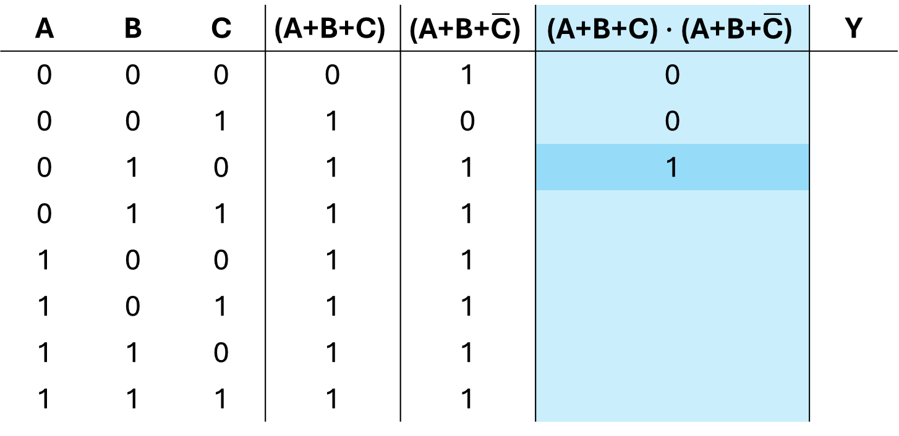
Truth Tables
$$\text{Y}\text{ =} \text{(}\text{A}\text{+}\text{B}\text{+}\text{C}\text{)}∙\text{(}\text{A}\text{+}\text{B}\text{+}\overline{\text{C}}\text{) + }\text{A}$$
A | B | C | $$\text{(}\text{A}\text{+}\text{B}\text{+}\text{C}\text{)}$$ | $$\text{(}\text{A}\text{+}\text{B}\text{+}\overline{\text{C}}\text{)}$$ | $$\text{(}\text{A}\text{+}\text{B}\text{+}\text{C}\text{)}∙\text{(}\text{A}\text{+}\text{B}\text{+}\overline{\text{C}}\text{)}$$ | Y
0 | 0 | 0 | 0 | 1 | 0
0 | 0 | 1 | 1 | 0 | 0
0 | 1 | 0 | 1 | 1 | 1
0 | 1 | 1 | 1 | 1
1 | 0 | 0 | 1 | 1
1 | 0 | 1 | 1 | 1
1 | 1 | 0 | 1 | 1
1 | 1 | 1 | 1 | 1

Slide 78
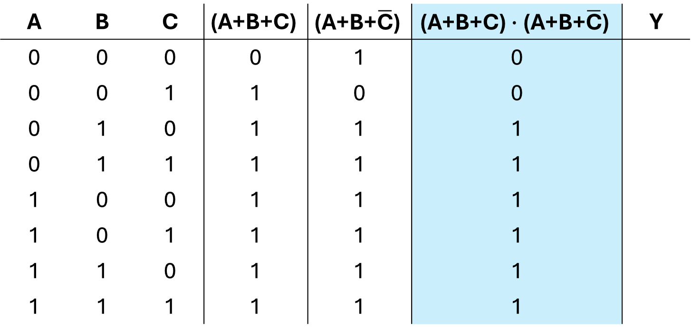
Truth Tables
$$\text{Y}\text{ =} \text{(}\text{A}\text{+}\text{B}\text{+}\text{C}\text{)}∙\text{(}\text{A}\text{+}\text{B}\text{+}\overline{\text{C}}\text{) + }\text{A}$$
A | B | C | $$\text{(}\text{A}\text{+}\text{B}\text{+}\text{C}\text{)}$$ | $$\text{(}\text{A}\text{+}\text{B}\text{+}\overline{\text{C}}\text{)}$$ | $$\text{(}\text{A}\text{+}\text{B}\text{+}\text{C}\text{)}∙\text{(}\text{A}\text{+}\text{B}\text{+}\overline{\text{C}}\text{)}$$ | Y
0 | 0 | 0 | 0 | 1 | 0
0 | 0 | 1 | 1 | 0 | 0
0 | 1 | 0 | 1 | 1 | 1
0 | 1 | 1 | 1 | 1 | 1
1 | 0 | 0 | 1 | 1 | 1
1 | 0 | 1 | 1 | 1 | 1
1 | 1 | 0 | 1 | 1 | 1
1 | 1 | 1 | 1 | 1 | 1

Slide 79
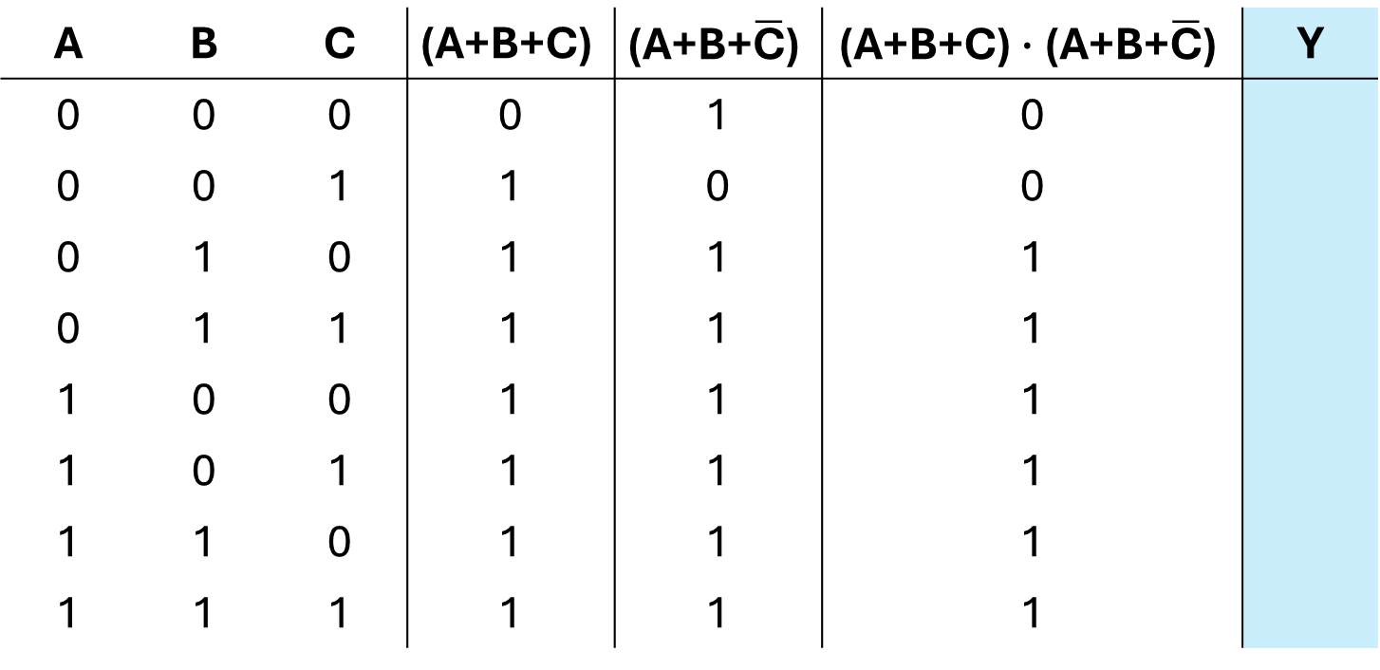
Truth Tables
$$\text{Y}\text{ =} \text{(}\text{A}\text{+}\text{B}\text{+}\text{C}\text{)}∙\text{(}\text{A}\text{+}\text{B}\text{+}\overline{\text{C}}\text{) + }\text{A}$$
A | B | C | $$\text{(}\text{A}\text{+}\text{B}\text{+}\text{C}\text{)}$$ | $$\text{(}\text{A}\text{+}\text{B}\text{+}\overline{\text{C}}\text{)}$$ | $$\text{(}\text{A}\text{+}\text{B}\text{+}\text{C}\text{)}∙\text{(}\text{A}\text{+}\text{B}\text{+}\overline{\text{C}}\text{)}$$ | Y
0 | 0 | 0 | 0 | 1 | 0
0 | 0 | 1 | 1 | 0 | 0
0 | 1 | 0 | 1 | 1 | 1
0 | 1 | 1 | 1 | 1 | 1
1 | 0 | 0 | 1 | 1 | 1
1 | 0 | 1 | 1 | 1 | 1
1 | 1 | 0 | 1 | 1 | 1
1 | 1 | 1 | 1 | 1 | 1

Slide 80
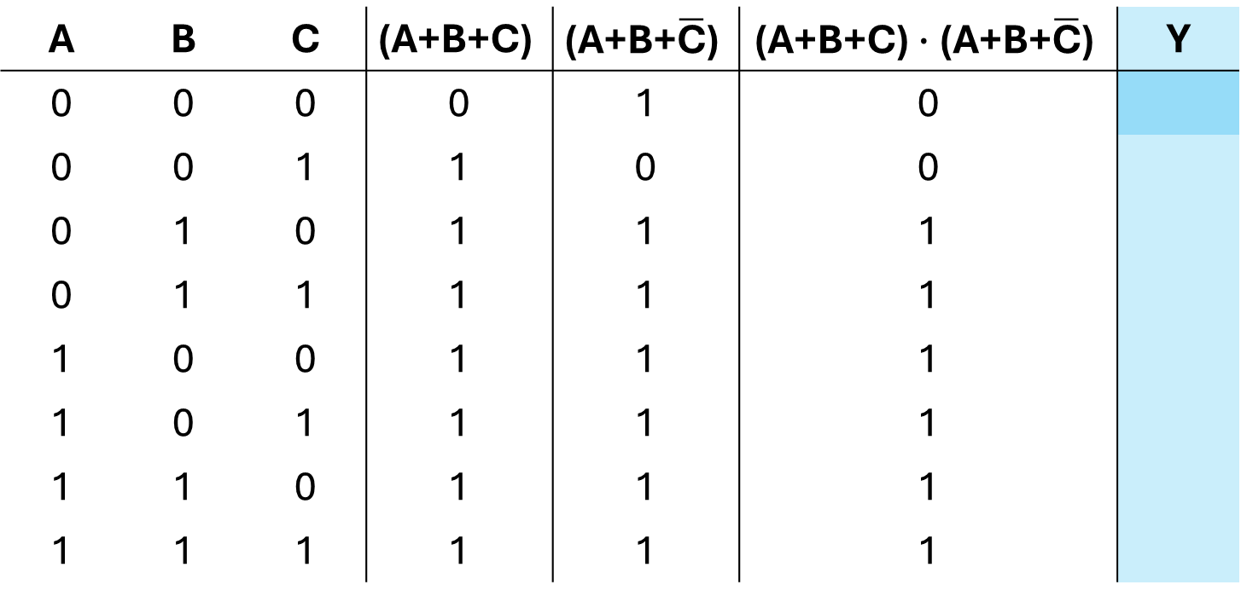
Truth Tables
$$\text{Y}\text{ =} \text{(}\text{A}\text{+}\text{B}\text{+}\text{C}\text{)}∙\text{(}\text{A}\text{+}\text{B}\text{+}\overline{\text{C}}\text{) + }\text{A}$$
A | B | C | $$\text{(}\text{A}\text{+}\text{B}\text{+}\text{C}\text{)}$$ | $$\text{(}\text{A}\text{+}\text{B}\text{+}\overline{\text{C}}\text{)}$$ | $$\text{(}\text{A}\text{+}\text{B}\text{+}\text{C}\text{)}∙\text{(}\text{A}\text{+}\text{B}\text{+}\overline{\text{C}}\text{)}$$ | Y
0 | 0 | 0 | 0 | 1 | 0
0 | 0 | 1 | 1 | 0 | 0
0 | 1 | 0 | 1 | 1 | 1
0 | 1 | 1 | 1 | 1 | 1
1 | 0 | 0 | 1 | 1 | 1
1 | 0 | 1 | 1 | 1 | 1
1 | 1 | 0 | 1 | 1 | 1
1 | 1 | 1 | 1 | 1 | 1

Slide 81
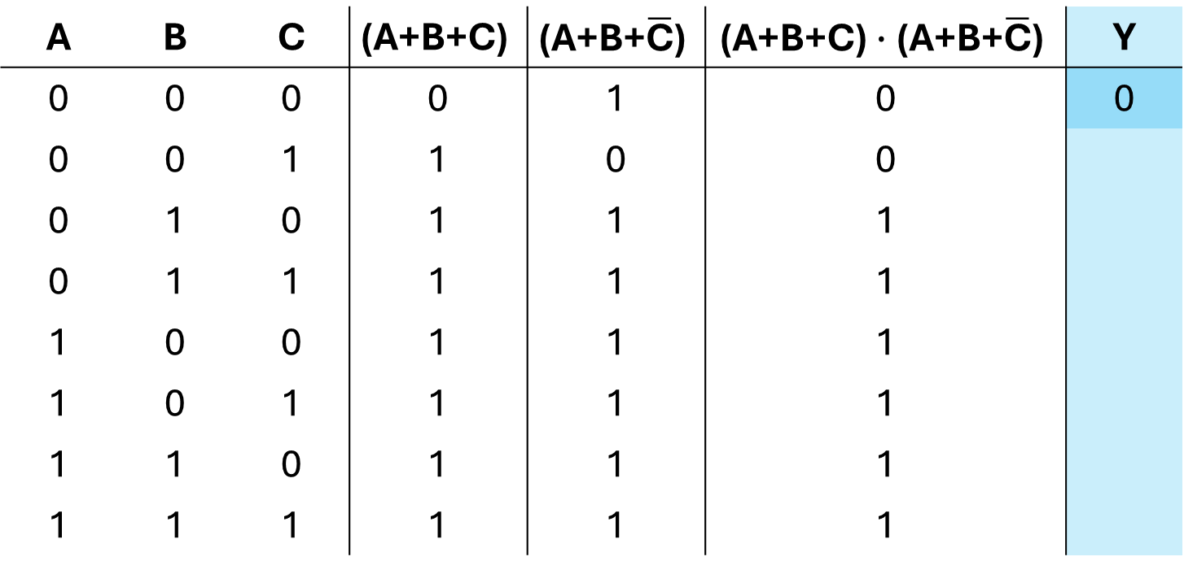
Truth Tables
$$\text{Y}\text{ =} \text{(}\text{A}\text{+}\text{B}\text{+}\text{C}\text{)}∙\text{(}\text{A}\text{+}\text{B}\text{+}\overline{\text{C}}\text{) + }\text{A}$$
A | B | C | $$\text{(}\text{A}\text{+}\text{B}\text{+}\text{C}\text{)}$$ | $$\text{(}\text{A}\text{+}\text{B}\text{+}\overline{\text{C}}\text{)}$$ | $$\text{(}\text{A}\text{+}\text{B}\text{+}\text{C}\text{)}∙\text{(}\text{A}\text{+}\text{B}\text{+}\overline{\text{C}}\text{)}$$ | Y
0 | 0 | 0 | 0 | 1 | 0 | 0
0 | 0 | 1 | 1 | 0 | 0
0 | 1 | 0 | 1 | 1 | 1
0 | 1 | 1 | 1 | 1 | 1
1 | 0 | 0 | 1 | 1 | 1
1 | 0 | 1 | 1 | 1 | 1
1 | 1 | 0 | 1 | 1 | 1
1 | 1 | 1 | 1 | 1 | 1

Slide 82
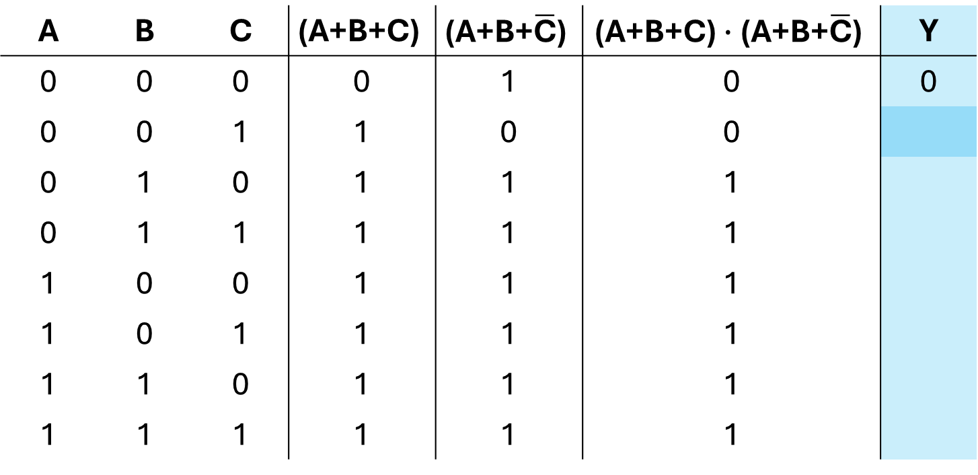
Truth Tables
$$\text{Y}\text{ =} \text{(}\text{A}\text{+}\text{B}\text{+}\text{C}\text{)}∙\text{(}\text{A}\text{+}\text{B}\text{+}\overline{\text{C}}\text{) + }\text{A}$$
A | B | C | $$\text{(}\text{A}\text{+}\text{B}\text{+}\text{C}\text{)}$$ | $$\text{(}\text{A}\text{+}\text{B}\text{+}\overline{\text{C}}\text{)}$$ | $$\text{(}\text{A}\text{+}\text{B}\text{+}\text{C}\text{)}∙\text{(}\text{A}\text{+}\text{B}\text{+}\overline{\text{C}}\text{)}$$ | Y
0 | 0 | 0 | 0 | 1 | 0 | 0
0 | 0 | 1 | 1 | 0 | 0
0 | 1 | 0 | 1 | 1 | 1
0 | 1 | 1 | 1 | 1 | 1
1 | 0 | 0 | 1 | 1 | 1
1 | 0 | 1 | 1 | 1 | 1
1 | 1 | 0 | 1 | 1 | 1
1 | 1 | 1 | 1 | 1 | 1

Slide 83

Truth Tables
$$\text{Y}\text{ =} \text{(}\text{A}\text{+}\text{B}\text{+}\text{C}\text{)}∙\text{(}\text{A}\text{+}\text{B}\text{+}\overline{\text{C}}\text{) + }\text{A}$$
A | B | C | $$\text{(}\text{A}\text{+}\text{B}\text{+}\text{C}\text{)}$$ | $$\text{(}\text{A}\text{+}\text{B}\text{+}\overline{\text{C}}\text{)}$$ | $$\text{(}\text{A}\text{+}\text{B}\text{+}\text{C}\text{)}∙\text{(}\text{A}\text{+}\text{B}\text{+}\overline{\text{C}}\text{)}$$ | Y
0 | 0 | 0 | 0 | 1 | 0 | 0
0 | 0 | 1 | 1 | 0 | 0 | 0
0 | 1 | 0 | 1 | 1 | 1
0 | 1 | 1 | 1 | 1 | 1
1 | 0 | 0 | 1 | 1 | 1
1 | 0 | 1 | 1 | 1 | 1
1 | 1 | 0 | 1 | 1 | 1
1 | 1 | 1 | 1 | 1 | 1

Slide 84
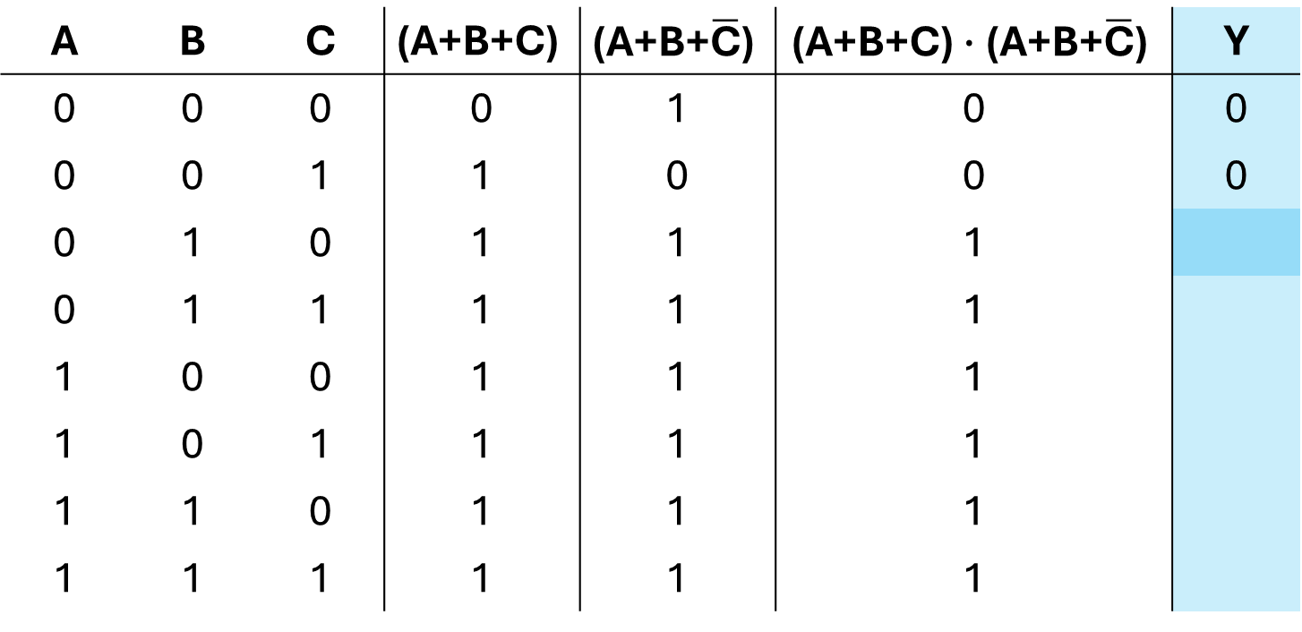
Truth Tables
$$\text{Y}\text{ =} \text{(}\text{A}\text{+}\text{B}\text{+}\text{C}\text{)}∙\text{(}\text{A}\text{+}\text{B}\text{+}\overline{\text{C}}\text{) + }\text{A}$$
A | B | C | $$\text{(}\text{A}\text{+}\text{B}\text{+}\text{C}\text{)}$$ | $$\text{(}\text{A}\text{+}\text{B}\text{+}\overline{\text{C}}\text{)}$$ | $$\text{(}\text{A}\text{+}\text{B}\text{+}\text{C}\text{)}∙\text{(}\text{A}\text{+}\text{B}\text{+}\overline{\text{C}}\text{)}$$ | Y
0 | 0 | 0 | 0 | 1 | 0 | 0
0 | 0 | 1 | 1 | 0 | 0 | 0
0 | 1 | 0 | 1 | 1 | 1
0 | 1 | 1 | 1 | 1 | 1
1 | 0 | 0 | 1 | 1 | 1
1 | 0 | 1 | 1 | 1 | 1
1 | 1 | 0 | 1 | 1 | 1
1 | 1 | 1 | 1 | 1 | 1

Slide 85
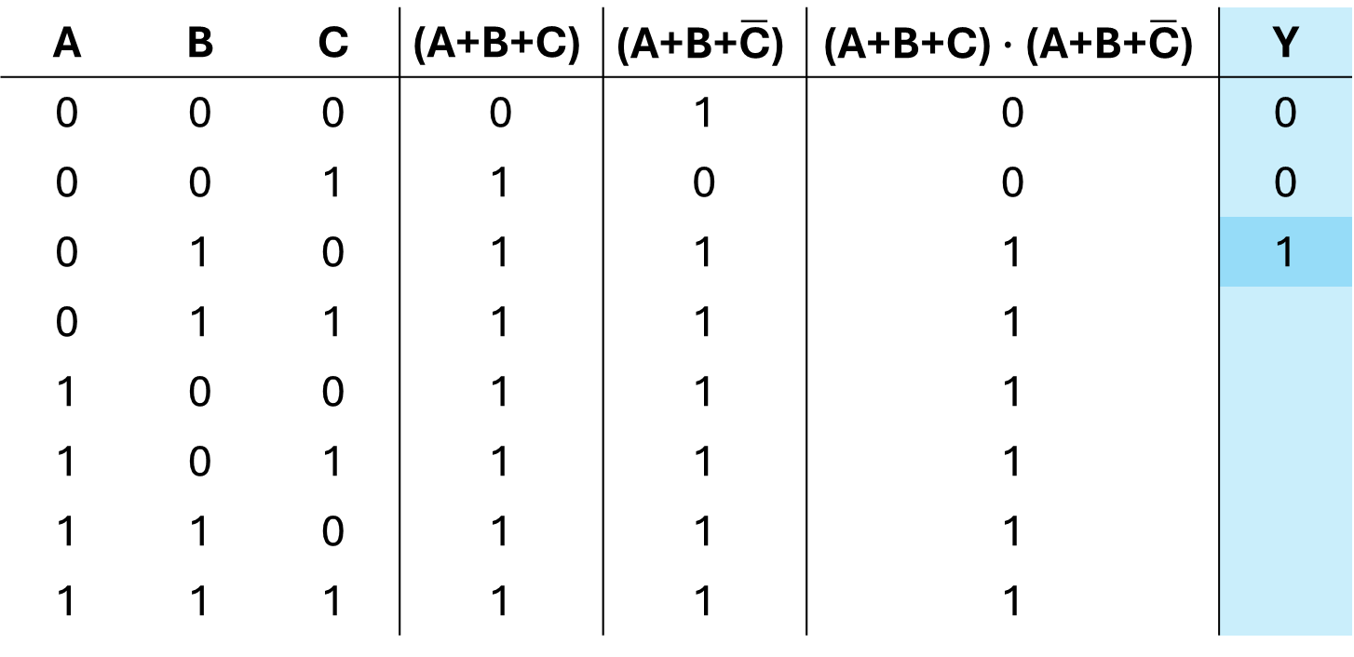
Truth Tables
$$\text{Y}\text{ =} \text{(}\text{A}\text{+}\text{B}\text{+}\text{C}\text{)}∙\text{(}\text{A}\text{+}\text{B}\text{+}\overline{\text{C}}\text{) + }\text{A}$$
A | B | C | $$\text{(}\text{A}\text{+}\text{B}\text{+}\text{C}\text{)}$$ | $$\text{(}\text{A}\text{+}\text{B}\text{+}\overline{\text{C}}\text{)}$$ | $$\text{(}\text{A}\text{+}\text{B}\text{+}\text{C}\text{)}∙\text{(}\text{A}\text{+}\text{B}\text{+}\overline{\text{C}}\text{)}$$ | Y
0 | 0 | 0 | 0 | 1 | 0 | 0
0 | 0 | 1 | 1 | 0 | 0 | 0
0 | 1 | 0 | 1 | 1 | 1 | 1
0 | 1 | 1 | 1 | 1 | 1
1 | 0 | 0 | 1 | 1 | 1
1 | 0 | 1 | 1 | 1 | 1
1 | 1 | 0 | 1 | 1 | 1
1 | 1 | 1 | 1 | 1 | 1

Slide 86
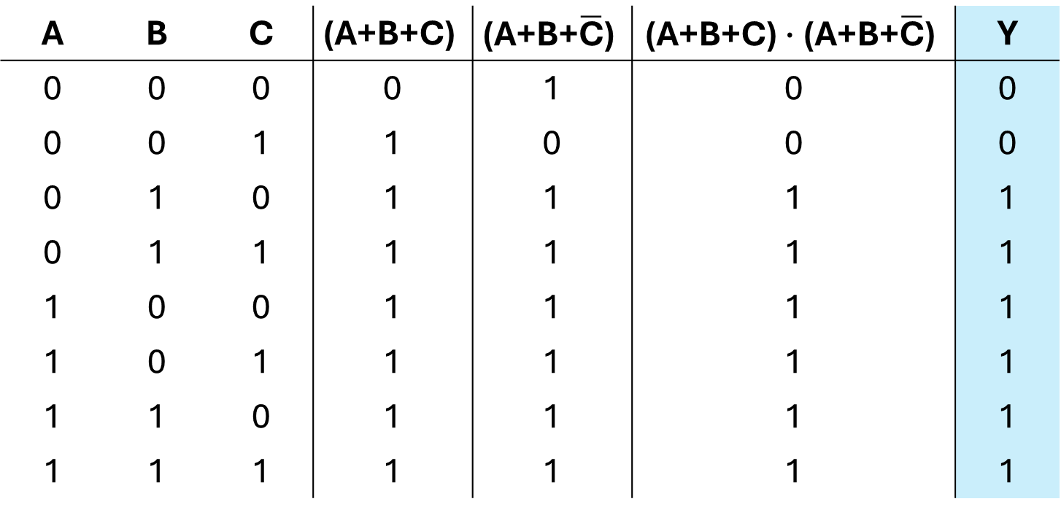
Truth Tables
$$\text{Y}\text{ =} \text{(}\text{A}\text{+}\text{B}\text{+}\text{C}\text{)}∙\text{(}\text{A}\text{+}\text{B}\text{+}\overline{\text{C}}\text{) + }\text{A}$$
A | B | C | $$\text{(}\text{A}\text{+}\text{B}\text{+}\text{C}\text{)}$$ | $$\text{(}\text{A}\text{+}\text{B}\text{+}\overline{\text{C}}\text{)}$$ | $$\text{(}\text{A}\text{+}\text{B}\text{+}\text{C}\text{)}∙\text{(}\text{A}\text{+}\text{B}\text{+}\overline{\text{C}}\text{)}$$ | Y
0 | 0 | 0 | 0 | 1 | 0 | 0
0 | 0 | 1 | 1 | 0 | 0 | 0
0 | 1 | 0 | 1 | 1 | 1 | 1
0 | 1 | 1 | 1 | 1 | 1 | 1
1 | 0 | 0 | 1 | 1 | 1 | 1
1 | 0 | 1 | 1 | 1 | 1 | 1
1 | 1 | 0 | 1 | 1 | 1 | 1
1 | 1 | 1 | 1 | 1 | 1 | 1

Slide 87

Equalities between Boolean expressions
Verify the following inequality using the properties of Boolean algebra
$$\text{A}\text{∙}\overline{\overline{\text{A}}\text{∙}\text{B} }\text{+ }\overline{\text{B}} \text{= }\text{A}\text{ + }\overline{\text{B}}$$
ex. 1, p. 81 Introduzione alla programmazione ARM

Slide 88

Equalities between Boolean expressions
Verify the following inequality using the properties of Boolean algebra
$$\text{A}\text{∙}\overline{\overline{\text{A}}\text{∙}\text{B} }\text{+ }\overline{\text{B}} \text{= }\text{A}\text{ + }\overline{\text{B}}$$
$$\text{A}\text{∙}\overline{\overline{\text{A}}\text{∙}\text{B} }\text{+ }\overline{\text{B}} \text{=}$$
ex. 1, p. 81 Introduzione alla programmazione ARM

Slide 89

Equalities between Boolean expressions
Verify the following inequality using the properties of Boolean algebra
$$\text{A}\text{∙}\overline{\overline{\text{A}}\text{∙}\text{B} }\text{+ }\overline{\text{B}} \text{= }\text{A}\text{ + }\overline{\text{B}}$$
$$\text{A}\text{∙}\overline{\overline{\text{A}}\text{∙}\text{B} }\text{+ }\overline{\text{B}} \text{=}$$
ex. 1, p. 81 Introduzione alla programmazione ARM

Slide 90

Equalities between Boolean expressions
Verify the following inequality using the properties of Boolean algebra
$$\text{A}\text{∙}\overline{\overline{\text{A}}\text{∙}\text{B} }\text{+ }\overline{\text{B}} \text{= }\text{A}\text{ + }\overline{\text{B}}$$
$$\text{A}\text{∙}\overline{\overline{\text{A}}\text{∙}\text{B} }\text{+ }\overline{\text{B}} \text{=}$$
De Morgan's Law: $\overline{\text{X}\text{∙}\text{Y}}\text{ =} \overline{\text{X}} \text{+ }\overline{\text{Y}}$
ex. 1, p. 81 Introduzione alla programmazione ARM

Slide 91

Equalities between Boolean expressions
Verify the following inequality using the properties of Boolean algebra
$$\text{A}\text{∙}\overline{\overline{\text{A}}\text{∙}\text{B} }\text{+ }\overline{\text{B}} \text{= }\text{A}\text{ + }\overline{\text{B}}$$
$$\text{A}\text{∙}\overline{\overline{\text{A}}\text{∙}\text{B} }\text{+ }\overline{\text{B}} \text{=}$$
De Morgan's Law: $\overline{\text{X}\text{∙}\text{Y}}\text{ =} \overline{\text{X}} \text{+ }\overline{\text{Y}}$
$$\text{A}\text{∙(}\text{A}\text{ +} \overline{\text{B}}\text{) + }\overline{\text{B}}\text{ =}$$
ex. 1, p. 81 Introduzione alla programmazione ARM

Slide 92

Equalities between Boolean expressions
Verify the following inequality using the properties of Boolean algebra
$$\text{A}\text{∙}\overline{\overline{\text{A}}\text{∙}\text{B} }\text{+ }\overline{\text{B}} \text{= }\text{A}\text{ + }\overline{\text{B}}$$
$$\text{A}\text{∙}\overline{\overline{\text{A}}\text{∙}\text{B} }\text{+ }\overline{\text{B}} \text{=}$$
De Morgan's Law: $\overline{\text{X}\text{∙}\text{Y}}\text{ =} \overline{\text{X}} \text{+ }\overline{\text{Y}}$
$$\text{A}\text{∙(}\text{A}\text{ +} \overline{\text{B}}\text{) + }\overline{\text{B}}\text{ =}$$
ex. 1, p. 81 Introduzione alla programmazione ARM

Slide 93


Equalities between Boolean expressions
Verify the following inequality using the properties of Boolean algebra
$$\text{A}\text{∙}\overline{\overline{\text{A}}\text{∙}\text{B} }\text{+ }\overline{\text{B}} \text{= }\text{A}\text{ + }\overline{\text{B}}$$
$$\text{A}\text{∙}\overline{\overline{\text{A}}\text{∙}\text{B} }\text{+ }\overline{\text{B}} \text{=}$$
De Morgan's Law: $\overline{\text{X}\text{∙}\text{Y}}\text{ =} \overline{\text{X}} \text{+ }\overline{\text{Y}}$
$$\text{A}\text{∙(}\text{A}\text{ +} \overline{\text{B}}\text{)}\text{ + }\overline{\text{B}}\text{ =}$$
ex. 1, p. 81 Introduzione alla programmazione ARM

Slide 94

Equalities between Boolean expressions
Verify the following inequality using the properties of Boolean algebra
$$\text{A}\text{∙}\overline{\overline{\text{A}}\text{∙}\text{B} }\text{+ }\overline{\text{B}} \text{= }\text{A}\text{ + }\overline{\text{B}}$$
$$\text{A}\text{∙}\overline{\overline{\text{A}}\text{∙}\text{B} }\text{+ }\overline{\text{B}} \text{=}$$
De Morgan's Law: $\overline{\text{X}\text{∙}\text{Y}}\text{ =} \overline{\text{X}} \text{+ }\overline{\text{Y}}$
$$\text{A}\text{∙(}\text{A}\text{ +} \overline{\text{B}}\text{)}\text{ + }\overline{\text{B}}\text{ =}$$
Absorption Law: $\text{X}$∙(X + Y) = X
ex. 1, p. 81 Introduzione alla programmazione ARM

Slide 95



Equalities between Boolean expressions
Verify the following inequality using the properties of Boolean algebra
$$\text{A}\text{∙}\overline{\overline{\text{A}}\text{∙}\text{B} }\text{+ }\overline{\text{B}} \text{= }\text{A}\text{ + }\overline{\text{B}}$$
$$\text{A}\text{∙}\overline{\overline{\text{A}}\text{∙}\text{B} }\text{+ }\overline{\text{B}} \text{=}$$
De Morgan's Law: $\overline{\text{X}\text{∙}\text{Y}}\text{ =} \overline{\text{X}} \text{+ }\overline{\text{Y}}$
$$\text{A}\text{∙(}\text{A}\text{ +} \overline{\text{B}}\text{)}\text{ + }\overline{\text{B}}\text{ =}$$
Absorption Law: $\text{X}$∙(X + Y) = X
$$\text{A}\text{ + }\overline{\text{B}}$$
ex. 1, p. 81 Introduzione alla programmazione ARM

